Slide 1




Starting a Conversation about Mental Health
Foundational Training for Students

Slide 2

Territory Acknowledgment

Slide 3
Session Objectives
Describe mental health and wellness.
Explore different models that help us understand and talk about mental health and mental illness.
Use accurate language to describe emotions and feelings.
Examine different ways we may respond to and manage stress and recognize that stress can be a positive signal to adapt to change.
Listen and respond in an empathetic way to students who are struggling, while maintaining healthy boundaries.

Slide 4
Understand Your Role
Because you interact with many other students, you are often in a position to recognize when another student may be in distress and need some support.
You are not expected to be a counsellor.
You can be a supportive person and connect another student to campus services and resources, such as counselling.

Slide 5
Structure of Session
This session covers four main areas:
Mental health and wellness
Language and marginalized groups
Stress and taking care of ourselves
Helping other students (how to respond and refer to students to campus and community resources)

Slide 6
Practical Information
Session is two hours long.
Questions and reflections are encouraged.
Handouts will be available at the end.
If online, remember to use the mute button.
If online, leaving your camera on is optional.

Slide 7
Support and Self-Care
Take any actions you need for your own well-being:
  Pause
  Ground yourself
  Take a break or leave (give us a thumbs up as you’re leaving so we know you’re okay)
Share only if you are comfortable.
If you need further support, reach out after the session.

Slide 8

Group Guidelines

Slide 9
Breathing Exercise
Relax your body and do the following:
Let out all of the air in your lungs to the count of four.
Keep your lungs empty for a count of four.
Inhale for a count of four.
Keep your lungs full for a count of four.

Slide 10
What Is Mental Health?

Slide 11
Defining Mental Health
Take a few moments to think about the following:
  What do you think of when you think of mental health?
  How would you define mental health?

Slide 12
One Definition of Mental Health
Mental health is the capacity of every individual to feel, think, and act in ways that enhance their ability to enjoy life and deal with challenges.
It is a positive sense of emotional and spiritual well-being that respects the importance of culture, equity, social justice, interconnections, and personal dignity.
Source: Public Health Agency of Canada. (n.d.). Mental health and wellness. https://cbpp-pcpe.phac-aspc.gc.ca/public-health-topics/mental-health-and-wellness

Slide 13
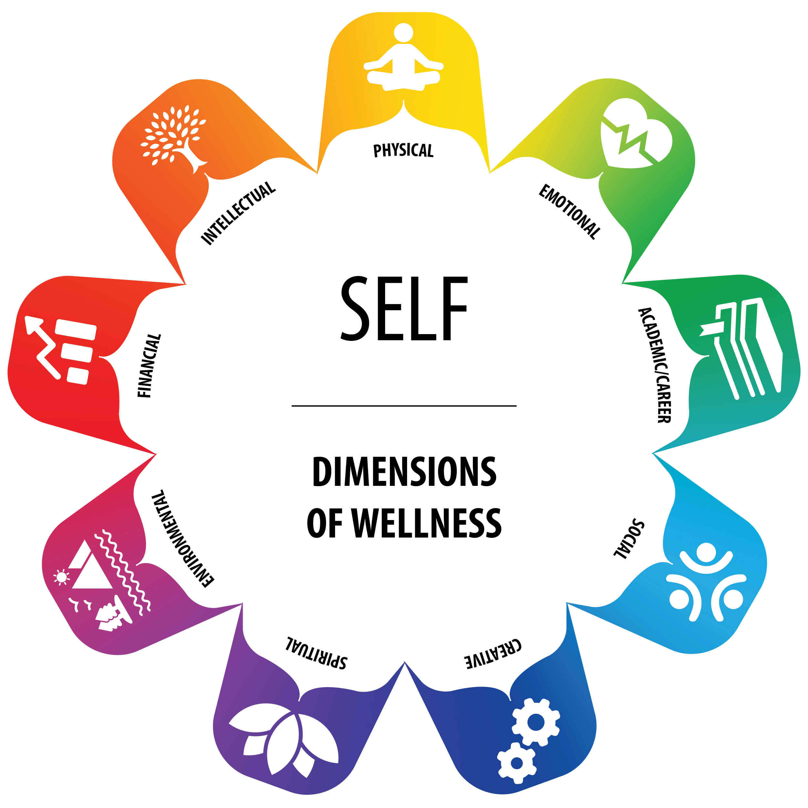
What Is Mental Wellness?

Slide 14
Wellness Wheel
The Wellness Wheel aligns with an Indigenous perspective that views individuals holistically.
Wellness is a state of balance.
All dimensions of wellness are interconnected.
All dimensions are equally important to finding balance.

Slide 15
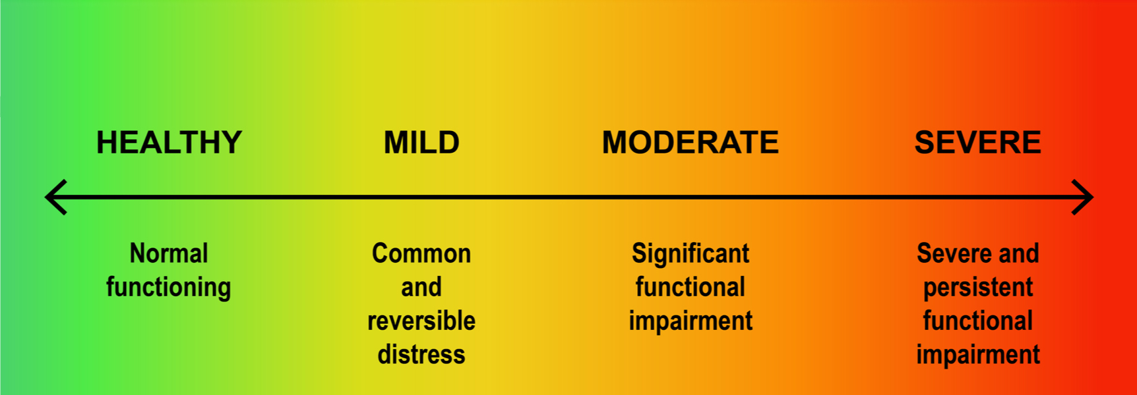
Mental Health Continuum
No Distress
Mental Distress
Mental Health Problem
Mental Illness

Slide 16
Mental Health and Mental Illness
Mental health
Capacity to think, feel, and act in ways that enhance our ability to:
Enjoy life
Deal with challenges
Mental health problems
Diminished capacities (cognitive, emotional, behavioural, etc.) that interfere with:
Enjoyment of life
Interactions with society and our environment
Mental illness
Conditions that affect a person’s thinking, feeling, mood, or behaviour, including:
Depression
Anxiety
Post-traumatic stress disorder (PTSD)

Slide 17
Mental Illness & Flourishing
People living with mental illness can have good mental health and be flourishing in their lives.

Slide 18
Dual Continuum Model of Mental Health and Mental Illness
Good mental health
Flourishing/thriving
with illness
Flourishing/thriving
without illness
Mental
illness
No mental
illness
Languishing/surviving
with illness
Languishing/surviving
without illness
Poor mental health

Slide 19
Talking About Feelings and Emotions
What mental health terms do we often use to talk about our feelings and emotions?

Slide 20
Activity: Words Matter
Consider how we often use these mental illnesses to describe our emotions:
“My boyfriend isn’t returning my texts. I’m so depressed.”
“I’m having a panic attack because I have three papers due next week.”
“I’ve just colour-coded all my books and files because I am so OCD!”
“I have so much going on in my life that I’m totally ADHD.”
“That exam was so hard and stressful it gave me PTSD.”

Slide 21
Marginalized Groups

Slide 22
Marginalized Groups and Mental Health
Students may face inequality and discrimination because of race, sexual orientation, or disability. This can affect mental health.
We can work to provide a culturally safe space for all students, including those who are:
  Indigenous
  LGBTQ2S+
  Living with a disability
  From racialized communities
  New to Canada (international students)
  Impacted by low socio-economic status

Slide 23

Reflection
As you think about students you know, what stresses might be specific to certain groups?

Slide 24
Let’s Talk about Stress

Slide 25
Rethinking Stress
The stress response is normal.
It signals our body to adapt.
Each time we adapt to a daily stressor, we develop the skills to be more resilient and cope with stress the next time.

Slide 26
Video: Why Stress is Good for You
This video from Scientific American explores the benefits of stress.
https://www.youtube.com/watch?v=ZlAI_FN3r0k

Slide 27
Stress Curve
Adapted from the Yerkes-Dodson Law

Slide 28
What Is Resilience?
Being able to adapt to challenges and setbacks
Finding ways to shift back toward balance and mental wellness
Noticing when stress appears and taking
proactive steps to manage it
The Stress Curve and Wellness Wheel can
help us recognize imbalance in our lives and
our resilience

Slide 29
Activity: Thinking about Stress
Consider one or more aspects of the Wellness Wheel.
If you feel comfortable, discuss:
  What stressors might fall under different parts of the wheel?
  How might students behave when they are facing these stressors?
  What strengths and resiliency might students show?
We’ll debrief in about 5 minutes.

Slide 30
Coping with Stress
1.
Remember stress is a signal to adapt
2.
Apply
effective coping skills
3.
Try a stress reduction technique

Slide 31
Taking Charge of Your Health
Sleep
Exercise
Nutrition
Social connections
Activities that give you a sense of purpose, such as helping others

Slide 32
Discussion: Taking Charge of Your Health
You can be a role model for others. You can be proactive with your own health and you can encourage your peers to engage in activities that will help them obtain and maintain good health.
What does this look like for you personally? Consider the ways in which you maintain your physical and mental health in different areas of your life.

Slide 33
Short Break

Slide 34
Helping Other Students

Slide 35
Reflection: Responding to Distress
Think of a time you were mildly or moderately distressed.
What did you need?

Slide 36
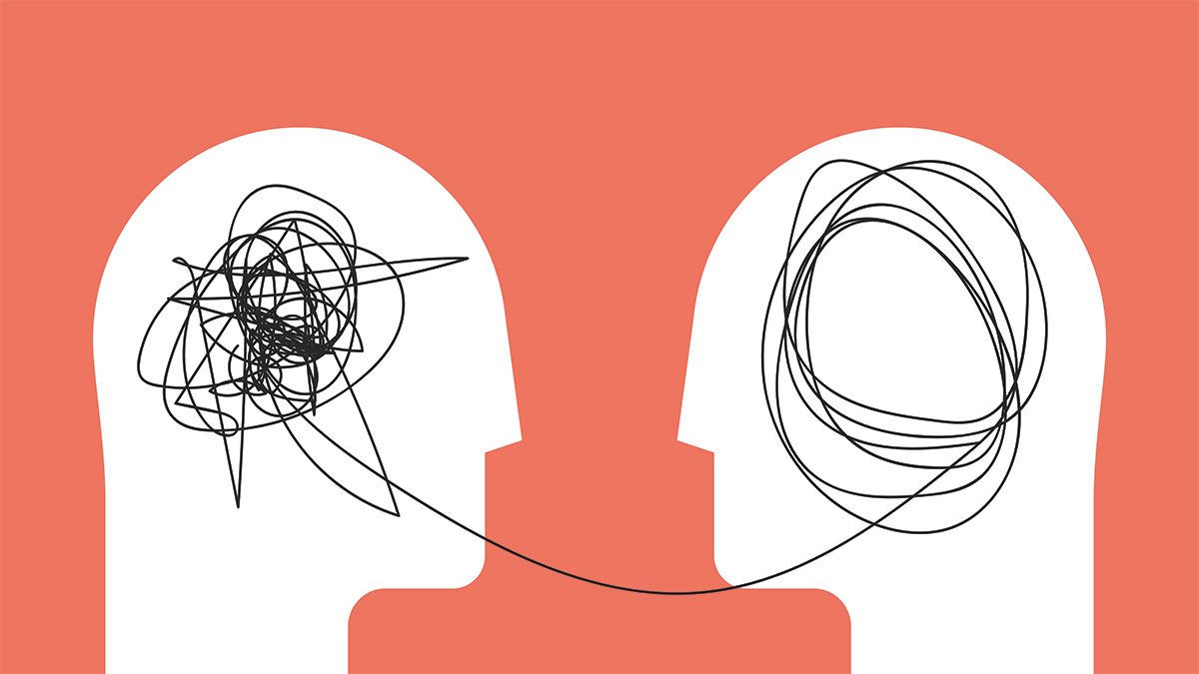
Empathetic Responses
Video:
Empathy
in Action

Slide 37
Video Reflection
What stood out for you about the video?
Is there anything you would like to add to the conversation about what would (or wouldn’t) be a supportive response?

Slide 38
Steps to Helping Others When
They’re Stressed
2.
Respond with empathy and normalize stress
3.
Ask open-ended questions
1.
Listen actively
4.
Review coping strategies and Wellness Wheel
5.
Identify key
next step(s)

Slide 39
Referring Students for Help on Campus
Counselling services
Campus security
Indigenous student centre
Health or medical services
International student services
Accessible learning centres
Pride centre
Sexualized violence support centre
Financial aid
Academic advising

Slide 40
Provincial Mental Health Resources
Mental Health Support Line: 310-6789
Here2Talk: 1-877-857-3397 (a 24-hour phone and chat counselling support for B.C. post-secondary students)
BC Suicide Line: 1-800-784-2433
KUU-US Crisis Line: 1-800-588-8717 (24-hour-crisis-line for Indigenous people)
First Nations Health Authority website lists Indigenous resources at (www.fnha.ca/what-we-do/ehealth

Slide 41
What To Do When You Are Concerned
If you’re concerned for another student’s immediate safety:
If it’s an emergency situation, (student has taken pills, is experiencing psycho, or is a danger to themselves or others), call 911 and campus security.
If it’s not an emergency, but you are concerned, offer to contact support services on the student’s behalf while they are with you.

Slide 42
If a Student Doesn’t Want Help
Consider student safety:
  Is anyone at risk of immediate harm?
  If yes, you need to consult and refer. You may need to call 911 and campus security.
If there is no risk of harm, a student has:
  A right to choose to get help.
  A right to privacy.

Slide 43
Maintaining Boundaries

Slide 44
Check In with Your Feelings
You feel responsible for the student.
You often think about how to solve the student’s problems.
You think the student’s problems are more than you can handle.
You feel stressed out by the student’s issues or behaviour.
You feel pressure to solve the student’s problems.
You feel uneasy or have a gut feeling that the student is not okay despite the student denying it.
You see a pattern repeating itself in your interactions with a student.
You find yourself avoiding the student.
You feel anxious or angry when the student approaches you.

Slide 45
Consult or Refer
We all have our limits, and it’s important to maintain boundaries. There are professionals you can consult or refer students to.
Consider referring or consulting if you:
  Are unsure about intervening
  Are uncertain how to respond
  Continue to be worried

Slide 46

Self-Care Brainstorm

Slide 47
Practice Scenarios
Read the scenario and discuss the following questions with your group:
How might you respond and offer support to another student?
What services might you suggest to the student?
Who might you consult with?
How does it feel to imagine offering support to the student in the scenario?

Slide 48
Scenario Debrief
What did you learn from your scenario?
What stood out for you?
Remember that there are many resources and services on campus and in the community that can support students.

Slide 49
Summary: Wellness Wheel

Slide 50
Summary: Mental Health Continuum
No Distress
Mental Distress
Mental Health Problem
Mental Illness

Slide 51
Summary: Stress Curve

Slide 52
Reflection
“I’ve learned that people will forget what you said, people will forget what you did, but people will never forget how you made them feel.”
— Maya Angelou

Slide 53

Questions or Comments

Slide 54
Thank You
If you need further information, please contact us.

Slide 55
Media Attributions
Cover Slide & Slide 19: Smooth turquoise water by Leo Rivas on Unsplash License
Slide 2: Lake in Dome Creek, BC by Jakub Fryš. https://commons.wikimedia.org/wiki/File:Lake_in_Dome_Creek.jpg. Creative Commons Attribution-Share Alike 4.0 International license.
Slide 12, 13, 26 & 46: Wellness Wheel © Jewell Gillies. Creative Commons Attribution 4.0 International license. ICONS » yoga by zidney from the Noun Project | heart rate by Naufal Hudallah from the Noun Project | Book by Studio TROISQUATRE from the Noun Project | Gears by Gregor Cresnar from the Noun Project | Lotus by Brad Avison from the Noun Project | landscape by Creative Stall from the Noun Project | forest by Creative Stall from the Noun Project | Sea Sunset by Creative Stall from the Noun Project | Park by Creative Stall from the Noun Project | gaining by Alice Design from the Noun Project | Tree by Brian Hurshman from the Noun Project
Slides 14 & 47: Mental Health Continuum © BCcampus based on the University of Victoria continuum of mental health, which is adapted from on Queen’s University continuum of mental health and the Canada Department of National Defence continuum of mental health
Slide 17: Dual-Continuum Model © BCcampus based on the conceptual work of Corey Keys and a diagram created by CACUSS and Canadian Mental Health Association is licensed under a CC BY-NC (Attribution NonCommercial) license.
Slide 22, 33, & 35: reflections of the heart by Álvaro Bueno, ES from the Noun Project. https://thenounproject.com/search/?q=2283668&i=2283668. CC BY license.
Slide 25 & 48: Stress Curve. Adapted from the Yerkes-Dodson Law and Performance, 1908.
Slide 34: Practicing Empathy. https://commons.wikimedia.org/wiki/File:Practicing-Empathy.jpg. CC BY license.
Slide 43: Flower of Indian Lotus by Hong Zang. Retrieved from https://commons.wikimedia.org/wiki/File:Lotus_flower_(978659).jpg This file is made available under the Creative Commons CC0 1.0 Universal Public Domain Dedication.
Slide 50: Diversity speech bubble icons by Louise Wigö. Retrieved from https://commons.wikimedia.org/wiki/File:Diversity_speech_bubble_icons.svg. This file is made available under the Creative Commons CC0 1.0 Universal Public Domain Dedication.

