Slide 1
Intro to Tourism & Hospitality
Chapter 5

Slide 2
Copyright
Introduction to Tourism and Hospitality in BC by Morgan Westcott, Editor, (c) Capilano University is used under a CC-BY 4.0 International license.
This chapter is by Don Webster and is used under a CC-BY 4.0 International license.

Slide 3
Learning Outcomes
Differentiate between recreation, outdoor recreation, adventure tourism, and nature-based tourism
Describe the significance, size, and economic contribution of this sector to the overall tourism industry in BC
Identify key industry organizations in recreation, outdoor recreation, and adventure tourism
Classify different subsectors of recreation, outdoor recreation, and adventure tourism
Recognize the unique challenges facing recreation, outdoor recreation, and adventure tourism in BC

Slide 4
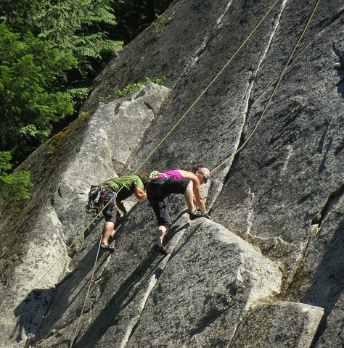
Overview
Recreation: the pursuit of leisure activities during one’s spare time (Tribe, 2011)
Outdoor recreation: in a natural setting
Adventure tourism: “a trip that includes at least two of the following three elements: physical activity, natural environment, and cultural immersion” (UNWTO, 2014)
Figure 5.1: Climbers in Squamish, BC

Slide 5
Overview, continued
Nature-based tourism: tourism experiences directly or indirectly dependent on the natural environment (Tourism BC, 2005b)
Adventure experience seekers: well-educated, rank natural beauty as highest factor selecting a destination (UNWTO, 2014)
69% of market travels to Europe, North America, South America
$263 billion in adventure spending to these destinations

Slide 6
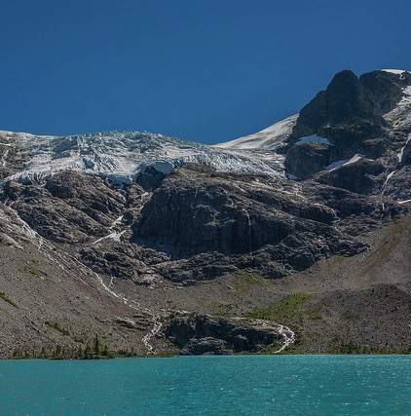
Recreation and Adventure Tourism in BC
Nearly all BC residents participate in outdoor in any year
2,200 outdoor/adventure operators in the province
21,000 jobs (2011)
$854 million in annual business revenues
(Tourism BC, 2013)
Figure 5.2: Joffre Lake Provincial Park

Slide 7
Land-Based Recreation and Tourism
Golf Courses and Resorts
Mountain Resorts and Nordic Centres
Off-Road Recreational Vehicles (ORVs)
Guest Ranches and Hunting Outfitters
Cycling
Camping and Hiking
Wildlife Viewing

Slide 8
Golf Courses and Resorts
Number one sport in Canada based on participation
Directly employs 155,000
Contributes more than $11 billion to GDP
BC has over 300 golf course facilities, 4th largest golf industry in Canada (Strategic Networks, 2009)
BC was voted the “Best Golf Course Destination in North America” in 2007 (Destination BC, 2014c)
Average golf traveller has a much higher than average income level, 50% earn more than $100,000 per year (Tourism BC, 2009c)

Slide 9
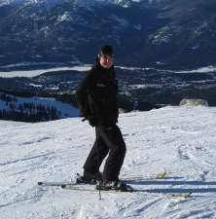
Mountain Resorts and Nordic Centres
Destination mountain resorts: large, offer greater range of amenities, generally marketed to visitors (e.g. Whistler Blackcomb)
Regional mountain resorts: smaller, fewer amenities, cater to the local community (Tourism BC, 2011c)
Nordic centres: cross-country skiing (longer season), over 50 centres in BC
Figure 5.3: Ready to ski down Blackcomb in Whistler

Slide 10
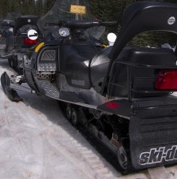
Off-Road Recreational Vehicles (ORV)
Any vehicle designed to be driven off-road that doesn’t fall under another classification
ATVs, snowmobiles, dirt bikes
Conflict between motorized trail users and non (e.g. ATVs vs mountain bikes)
Off-road vehicle act 2014
Figure 5.4: Snowmobiles

Slide 11
Guest Ranches and Hunting Outfitters
Ranches (57 in BC):
Home-like vacations
Horseback riding
Cattle wrangling
Authentic ranch experience
E.g. Hills Health Ranch
Outfitters:
Provide commercial hunting services
5000 non-resident licenses in BC
$116 million in economic activity each year
For some species, a guide outfitter must be used by law

Slide 12
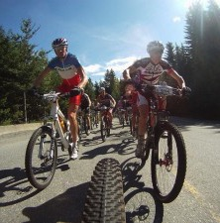
Cycling
44% of BC residents participate each year (Tourism BC, 2013)
1 million Canadians who had travelled to BC over 2 years participated in cycling (Tourism BC, 2009)
Road cycling: on paved roads, includes racing, touring
Mountain biking: unpaved routes and trails - $10.3 million to local economies (WCMBTA, 2006)
Figure 5.5: Cyclists in action

Slide 13
Camping and Hiking
In 2012, over 19.3 million people visited BC provincial parks (BC Parks, 2012)
2.3 were overnight visitors
Generated $15.5 million in user fees
Average guest satisfaction rating of 82%
Also multiple private camping operators in the province

Slide 14
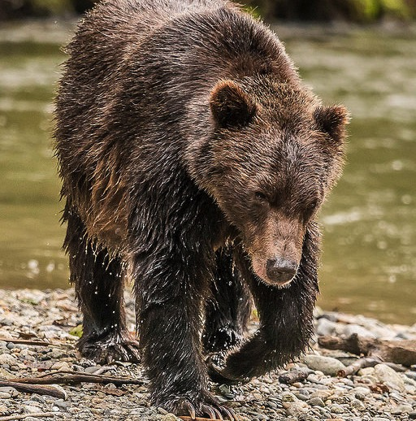
Wildlife Viewing
Includes whale, bird, bear watching as well as flora (e.g. wildflowers)
Approx 37% of toursts take part in wildlife viewing
For 13% of visitors it was the main reason for visiting BC
(CTC, 2007)
Figure 5.6: A bear in Bute Inlet, BC

Slide 15
Water-Based Recreation and Tourism
Scuba Diving
Sport Fishing and Lodges
Paddle Sports

Slide 16
Scuba
BC waters offer an abundance of wildlife, flora, and underwater terrain (reefs, sunken vessels, etc.)
In 2004: 116 operators with gross revenues for all at $15 million
This $15 million is just direct dive spending, figure is much higher when other trip factors included
Ivanova, 2004

Slide 17
Sport Fishing and Lodges
Historically one of BC’s first tourism draws
In 2009, there were 600,000 anglers (fresh and saltwater) in the province
Non-resident anglers contributed $6 million in licensing fees and additional $46 million in non-fishing spending
(Tourism BC, 2009)

Slide 18
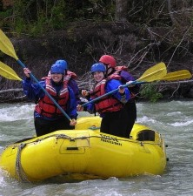
Paddle Sports
River rafting, canoeing, sea kayaking, standup paddle boarding (SUP)
Rafting = 216,000 customers and $15 million in gross revenues, 75% of participants were visitors
(Tourism BC, 2007)
114 sea kayak operators with $14 million in gross revenues
(Tourism BC, 2005a)
Figure 5.7: Rafting with COA in Squamish

Slide 19
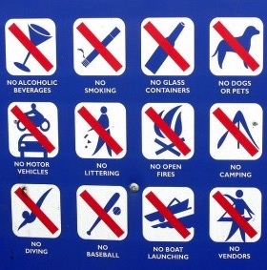
Trends and Issues
Land use disputes
Environmental impacts
Deforestation, resource extraction have negative effect on recreation sites
Visitors can also negatively impact sites
Risk management concerns
Figure 5.8: Nothing is allowed here!

Slide 20
Conclusion
Despite challenges the sector remains exciting, dynamic, and growing
Employment opportunities abound (especially for entrepreneurs)
Concerns and conflicts about land use and competition for resources
Pay special attention to risk management

Slide 21
References
BC Parks. (2012). 2011/2012 Statistics Report. Retrieved from http://www.env.gov.bc.ca/bcparks/research/statistic_report/statistic_report_2012.pdf
Canadian Tourism Commission. (2007). TAMS 2006-Canadian activity profile: Wildlife viewing while on trips. Retrieved from: corporate.canada.travel/sites/default/files/pdf/Research/Product-knowledge/TAMS/Canadian%20Travellers%20Outdoor%20Activity/CDN_Wil
Destination BC. (2014c). Golfing. Retrieved from: http://www.hellobc.com/british-columbia/things-to-do/outdoor-activities/golf.aspx
Ivanova, I. (2004). Recreational diving in British Columbia survey report. Retrieved from: http://www.destinationbc.ca/getattachment/Research/Research-by-Activity/Water-based/Recreational_Scuba_Diving_in_British_Columbia-sflb.pdf.aspx
Strategic Networks, Inc. (2009). Economic impact for golf in Canada. Retrieved from: http://www.pgaofcanada.com/Userfiles/SNG_NAGA_Impact%20GolfCanada_2009_KeyFindings_EN_Issued%20Aug17_09(1).pdf

Slide 22
References
Tourism BC. (2005a). British Columbia River Outfitters report. Retrieved from: http://www.destinationbc.ca/Research/Research-by-Activity/Water-based.aspx#.VIYlbb4irzI
Tourism BC. (2005b). Characteristics of commercial nature-based tourism industry in British Columbia. Retrieved from: http://www.destinationbc.ca/getattachment/Research/Research-by-Activity/Land-based/Economic_Impacts_of_Commercial_Nature-Based_Tourism_Report-sflb.pdf.aspx
Tourism BC. (2007a). British Columbia’s sea kayaking sector 2005. Retrieved from: http://www.destinationbc.ca/getattachment/Research/Research-by-Activity/All-Research-by-Activity/British-Columbia-s-Sea-Kayakers-Report-(2005),-Dec/British_Columbia_s_Sea_Kayakers_Report_2005-sflb.pdf.aspx
Tourism BC. (2007b). Travel activities and motivations of Canadian residents: An overview. Retrieved from: http://www.destinationbc.ca/getattachment/Research/Travel-Motivations-(TAMS)/Canadian-Travel-Motivations/Canadian_TAMS_Overview_Report.pdf.aspx
Tourism BC. (2009a). Fishing product overview. Retrieved from: http://www.destinationbc.ca/getattachment/Research/Research-by-Activity/Water-based/Fishing_Sector_Profile.pdf.aspx
Tourism BC. (2009b). Golf sector profile. Retrieved from: http://www.destinationbc.ca/getattachment/Research/Research-by-Activity/Land-based/Golf_Sector_Profile.pdf.aspx
Tourism BC. (2009c). Wildlife viewing product overview. Retrieved from: http://www.destinationbc.ca/getattachment/Research/Research-by-Activity/Land-based/Wildlife_Viewing_Sector_Profile.pdf.aspx

Slide 23
References
Tourism BC. (2011a). Guest ranchers business survey 2008/2009. Retrieved from: http://www.destinationbc.ca/getattachment/Research/Research-by-Activity/All-Research-by-Activity/Guest-Ranchers-Business-Survey-2008-2009,-January/GuestRanchersReport2008_2009.pdf.aspx
Tourism BC. (2011b). Mountain bike tourism guide. Retrieved from: http://www.destinationbc.ca/Research/Research-by-Activity/Land-based.aspx#.VIYqOr4irzI
Tourism BC. (2011c). The value of mountain resorts to the British Columbia economy. Retrieved from: http://www.destinationbc.ca/getattachment/Research/Research-by-Activity/All-Research-by-Activity/Value-of-Mountain-Resorts-to-the-British-Columbia/Value_of_Mountain_Resort_Properties_Phase_One_June-2012.pdf.aspx
Tourism BC. (2013). 2009/2010 Outdoor recreation study. Retrieved from: http://www.destinationbc.ca/getattachment/Research/Research-by-Activity/All-Research-by-Activity/Outdoor-Recreation-Study-2009-2010,-January-2013/Outdoor-Recreation-for-Distribution-14Jan13-FINAL-DRAFT-(2).pdf.aspxTribe, 2011
Tribe, J. (2011). The economics of recreation, leisure, and tourism. 4th Edition. Oxford, England: Elsevier.
United Nations World Tourism Organization. (2014). Global report on adventure tourism. Retrieved from: http://affiliatemembers.unwto.org/publication/global-report-adventure-tourism
Western Canada Mountain Bike Tourism Association. (2006). Sea-to-sky mountain biking economic impact study. Retrieved from: http://www.mbta.ca/assets/pdfs/S2S_E_I_Study.pdf

Slide 24
Attributions
Figure 5.1 Up and over by Ruth Hartnup is used under a CC-BY 2.0 license.
Figure 5.2 Row Your Boat by Matt Hosford is used under a CC-BY 2.0 license.
Figure 5.3 Blackcomb by Jeff Wilcox is used under a CC-BY 2.0 license.
Figure 5.4 Snowmobiling by Shazron is used under a CC-BY 2.0 license.
Figure 5.5 Cyclists by Jason Sager is used under a CC-BY-SA 2.0 license.
Figure 5.6 A bear in Bute Inlet, BC by John Critchley is used under a CC-BY 2.0 license.
Figure 5.7 Rafting Adventure in Squamish, BC by Raj Taneja is used under a CC-BY-NC 2.0 license.
Figure 5.8 Absolutely Nothing is Allowed Here by Vicki & Chuck Rogers is used under a CC-BY-NC-SA 2.0 license.

