Slide 1
Intro to Tourism & Hospitality
Chapter 4

Slide 2
Copyright
Introduction to Tourism and Hospitality in BC by Morgan Westcott, Editor, (c) Capilano University is used under a CC-BY 4.0 International license.
This chapter is by Keith Peter Briscoe and Griff Tripp and is used under a CC-BY 4.0 International license.

Slide 3
Learning Objectives
Describe the origins and significance of the food and beverage sector
Relate the importance of the sector to the Canadian economy
Explain the various types of food and beverage providers
(Briscoe, P. & Tripp, G., n.d.)

Slide 4
Learning Objectives
Discuss differing needs and desires of residents and visitors in selecting a food and beverage provider
Examine factors that contribute to the profitability of food and beverage operations
Discuss key issues and trends in the sector including government influence, health and safety, human resources, and technology
(Briscoe, P, & Tripp, G., n.d.)

Slide 5
F & B - Overview
In 2014, Canadian food and beverage businesses accounted for 1.1 million employees
More than 88,000 locations across the country
Estimated $71 billion in sales
Around 4% of the country’s overall economic activity.
(Restaurants Canada, 2014a)

Slide 6
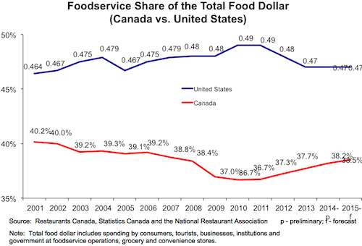
F & B Sector Performance
Figure 4.1. Foodservice spending as a percentage of total food dollars spent in Canada and the US

Slide 7
Type of F & B Providers
Two key distinctions:
commercial foodservice, which comprises operations whose primary business is food and beverage
non-commercial foodservice establishments where food and beverages are served, but are not the primary business
(Briscoe, P & Tripp, G, n.d.)

Slide 8
F & B Commercial Operators
Quick Service (QSRs)
Full-Service
Fine dining
Family Casual
Ethnic
Upscale
(Restaurants Canada, 2014b)

Slide 9
F & B Catering
Catering companies
Conference centers
Conference hotels
Wedding venues
Festival food coordinators
(Restaurants Canada, 2014b)

Slide 10
F & B Drinking
Liquor licenses divided into:
Liquor Primary
Food Primary
(Briscoe, P. & Tripp, G., n.d.)

Slide 11
F & B Non-Commercial
Institutional
Hospitals
Universities, colleges, and other educational institutions
Prisons and other detention facilities
Corporate staff cafeterias
Cruise ships
Airports and other transportation terminals and operations
(Restaurants Canada, 2014b)

Slide 12
F & B Non-Commercial
Accommodation Foodservice
Hotel restaurants and bars
Room service
Self-serve dining operations (such as a breakfast room)
(Restaurants Canada, 2014b)

Slide 13
F & B Non-Commercial
Vending and Automated Foodservices
Automated and vending services do account for significant sales for both small and large foodservice and accommodation providers
(Restaurants Canada, 2014b)

Slide 14
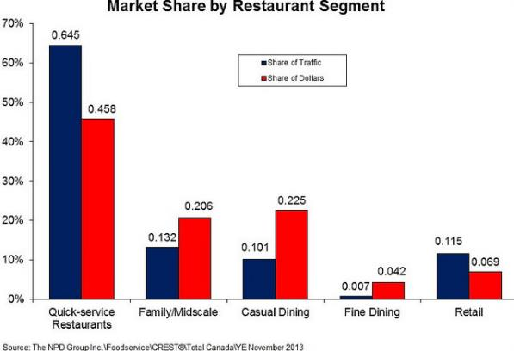
Figure 4.9 Share of market for different restaurant segments

Slide 15
Types of F & B Customers
Two key markets:
Residents
Food and Drink primary
Food and Drink secondary
Visitors
Cater completely to visitors or
Cater primarily to residents
(Smart, 2003; Heroux, 2002; Mak, Lumbers, Eves, & Chang, 2012)

Slide 16
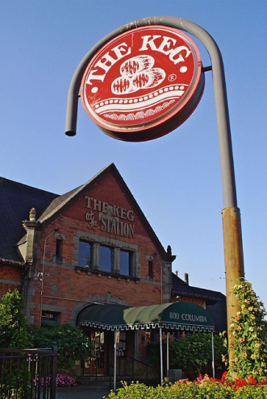
F & B continued
Profitability
Location, location, location
Cost Control
Sales and Marketing
Figure 4.3 The Keg at the Station is in a former train
station in New Westminster, BC

Slide 17
F & B Staffing and HR

Slide 18
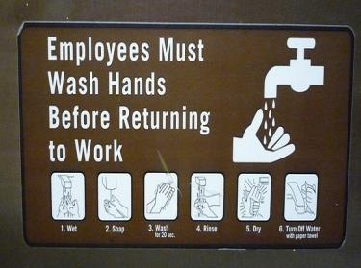
F & B Trends and Issues
Government Influence
Health and Safety
Technology
Figure 4.14 A sign in a Starbucks location encouraging staff to wash their hands to prevent the spread of germs

Slide 19
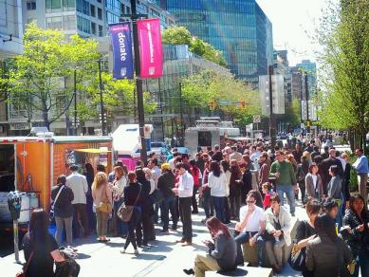
F & B Changing Venues
The third space
Taking it to the streets
Pop-up restaurants
Figure 4.15 Tacofino (closest), Pig on the Street, and Mom’s Grilled Cheese food trucks welcome crowds to their portable kitchens in downtown Vancouver.

Slide 20
References
Briscoe, P. & Tripp, G., (n.d.) Food and Beverage Services. In Westcott, M. Editor, Introduction to Tourism and Hospitality in BC (pp. 72-101). Retrieved from http://opentextbc.ca/introtourism/chapter/chapter-4-food-and-beverage-services/
Heroux, L. (2002). Restaurant marketing strategies in the United States and Canada: A comparative study. Journal of Foodservice Business Research, 5(4), 95-110.
Restaurants Canada (2014a). Foodservice facts. Retrieved from https://www.restaurantscanada.org/en/Book-Store/Product/rvdsfpid/2013-foodservice-facts-7
Restaurants Canada (2014b). Market review and forecast 2014. Retrieved from https://restaurantscanada.org
Restaurants Canada, Statistics Canada, fsSTRATEGY Inc. and Pannell Kerr Forster. (2013). Sector sales and market shares for 2012/13. Retrieved from www.restaurantscanada.org/en/Research#crfaResearchReports
Smart, J. (2003). Ethnic entrepreneurship, transmigration, and social integration: an ethnographic study of Chinese restaurant owners in rural western Canada. Urban Anthropology and Studies of Cultural Systems and World Economic Development, 311-342.

Slide 21
Attributions
Figure 4.1 Foodservice Share of Total FoodDollars by LinkBC is used under a CC-BY-NC 2.0 license.
Figure 4.3 The Keg at the Station by Jon the Happy Web Creative is used under a CC BY 2.0 license.
Figure 4.9 Market Share by Restaurant Segment by LinkBC is used under a CC-BY-NC 2.0 license.
Figure 4.14 must wash hands by Ambernectar13 is used under CC BY-ND 2.0 license.
Figure 4.15 Vancouver food carts on a sunny day by Christopher Porter is used under a CC BY-NC-ND 2.0 license.

