Slide 1




Consent & Sexual Violence
Notes:
Consent & Sexual Violence Training and Facilitator Guide: Preventing and Responding to Sexual Violence in BC Post-Secondary Institutions, Sexual Violence Training Development Team is licensed under a Creative Commons Attribution 4.0 International License, except where otherwise noted.
Mountain image by Mads Schmidt Rasmussen on Unsplash

Slide 2
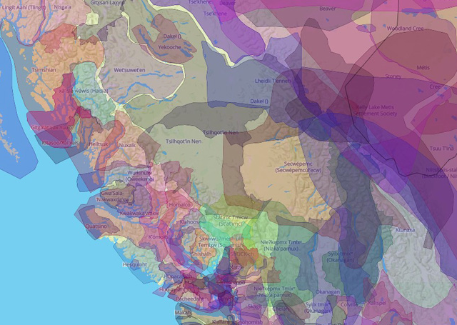
Territory Acknowledgment
I respectfully acknowledge [insert institution] is on the unceded and traditional territories of the [insert local] Nations
Notes:
5 minutes
Land Acknowledgement
Will have to be specific to location of facilitator as well as learners if training is delivered online
Share the link to: native-land.ca and encourage participants to visit, utilize and share
Facilitators are encouraged to discuss how their institution and/or campus unit/department is demonstrating accountability to the Indigenous communities and peoples whose land they are on
Specific work and collaborative projects in this area
Make a connection between land and consent - how this is an important connection because Canada as a nation is built upon a fundamental lack of consent of Indigenous peoples
“It is important to recognize the land today because some of the topics we are going to talk include boundaries and respect. This connects to which groups have power in our society. In particular, we continue to witness the historical and ongoing ways in which Indigenous peoples are denied land and bodily sovereignty within Canada by violence and force.”
“Today we will talk about creating communities and cultures of care of respect, where everyone can learn and grow. We start by acknowledging the importance of recognizing the impacts on the land and lives of Indigenous peoples in Canada as our personal and collective action towards reconciliation.”

Slide 3
Workshop Overview
Define sexual violence and consent
Explore personal, social, and cultural aspects of consent
Practice strategies related to asking for and giving consent
Identify ways of creating a culture of consent
Notes:
3 minutes
Share with learners the importance of seeing this training as an opportunity to model honesty and curiosity; encourage their engagement with the content and invite them to think of questions/ideas/step into the training.
Definition of consent: this training goal is to provide with different definitions of consent including the legal definition.
Explore consent from personal, cultural and societal stances: the facilitator/s will promote a participatory conversation that explores these areas through engaging activities in the large group. It is important to bring forward the knowledge of the learners to be aware of their own understandings and unique experiences. These explorations and activities will engage the group actively with the training. The training will explore what consent looks like in different relationships and the importance to practice consent in all of them, not only when dating or in intimate relationships.
Practicing and embodying a culture of consent: provide accessible language and practice some (non-triggering) scenarios where one experiences and/or witnesses an instance of consent and/or rejection.

Slide 4
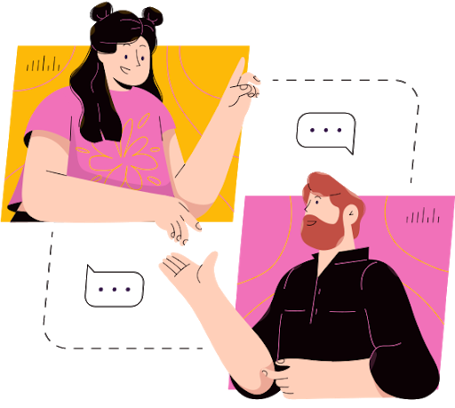
Group Agreement
Assume there are survivors in the space
Use the pronouns people use for themselves
Share the learning, not the names or stories
Take care of you
Ask questions
Respect and no judgement
You have the right to pass
We offer suggestions and ideas
We do not give advice
Notes:
5 minutes
Refer to the Activities section of the Facilitator Guide: Slide 4: Participatory Group Agreement
Assume there are survivors in the space: Whether it’s here or in the work you do, we work under the assumption that there are people who have been directly or indirectly affected by sexual violence in the space. When speaking and sharing, we always remind ourselves that we are communicating directly to survivors.
Share the learning, not the stories: We encourage you to share the skills you learn today during orientations and in your everyday lives. I’d encourage you to think if this is a safe place to share personal stories, and if so, I’d like us all to keep those stories private.
Take care of you: Today we are going to talk about harmful comments and sexual violence, and these topics might be uncomfortable or new to some of you. I trust you to listen to your bodies and take care of your own needs – that might mean getting up to stretch, or stand, leaving to go to the bathroom, getting some water, whatever you need.
Ask questions: We are all coming into this space with different experiences and knowledge. We encourage participants to engage with material that may challenge you from a place of curiosity, and ask questions if clarification is needed
Respect: With that being said, it’s also important to respect other people’s questions and viewpoint even though they are different than our own. Respect includes learners and facilitators using their names, pronouns, and terms they use for themselves
You have the right to pass: Or not participate in a group activity at any time. Taking care of YOU is the most important.
[image is from RTD Training PPT]

Slide 5
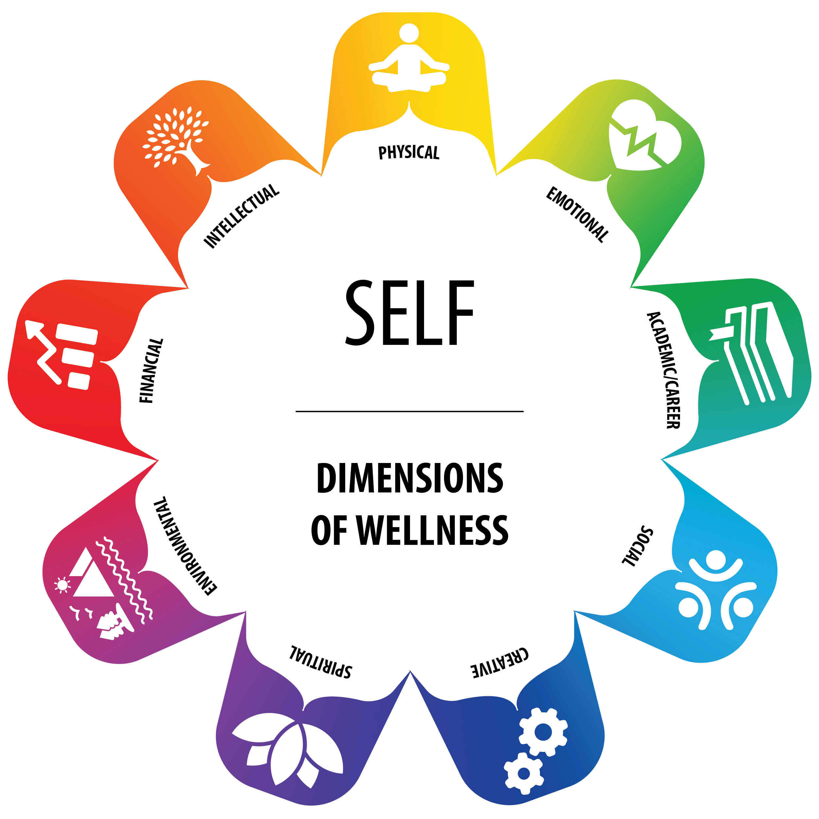
Self-Care Assessment
What 3 things that can help you feel grounded or calm when reading or learning about a difficult topic?
Is there a support person (friend, family member, counsellor, campus support, spiritual leader, elder, etc.) that you can turn to after this session if you are feeling overwhelmed or uncomfortable? Write their name.
What is one relaxation or mindful activity you can do after the session to take care of yourself (e.g., physical movement, rest, getting creative, going outdoors, connecting with people or animals, etc.)?
Notes:
5 minutes
Refer to the Activities section of the Facilitator Guide: Slide 5: Self Care Assessment
Please write down on your answers on a separate piece of paper or take a screenshot of this slide
On the left are some questions to consider when you think about taking care of yourself during and after this session. On the right is a Wellness Wheel tool that you can use to check-in with on your own or in the company of someone else.
The Wellness Wheel aligns with Indigenous traditional practices that view individuals holistically, recognizing that wellness means being in a state of balance with the physical, emotional, academic/career, social, creative, spiritual, environmental, financial, and intellectual aspects of your life.
Take 3 minutes to reflect on how you can best care for yourself during and and after this session. We recognize that this group is its own small community and that if you have capacity, you’ll do your part as a member to show care for those around you.
Wellness Wheel Handout, Capacity to Connect: Supporting Students’ Mental Health, © Jewell Gillies, Creative Commons
Attribution 4.0 International license. (See facilitator guide for information about downloading and sharing this resource).

Slide 6
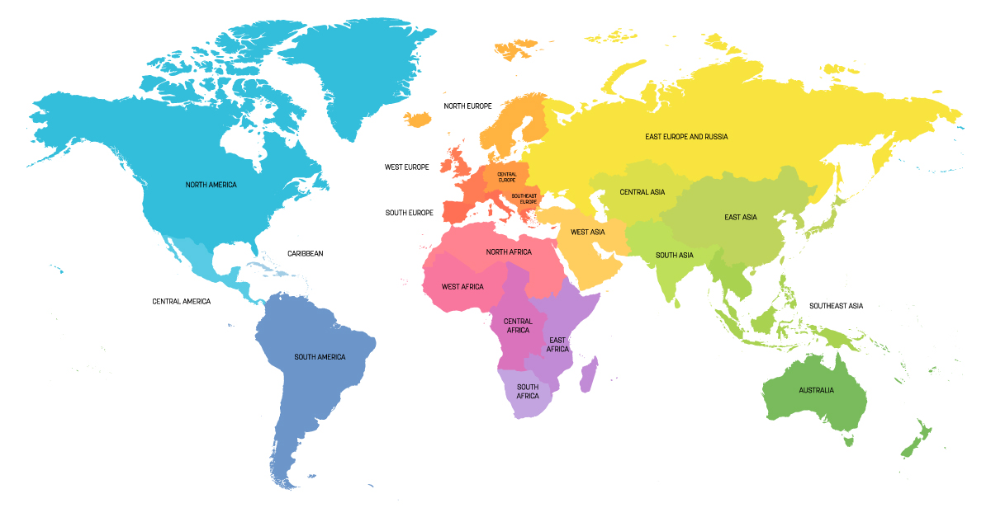
Where Do You and Your Ancestors Come From?
Notes:
5 minutes
Refer to the Activities section of the Facilitator Guide: Slide 6: Where are you and your ancestors from?
While we wish we could get to know each of you and your backgrounds, given the limitation of time, we are sharing this map with the intention to make space for your backgrounds and the backgrounds of your ancestors.
F2F: Please place a sticky note on the world map on the wall
Online: Using your annotation tool, please Stamp the spot on the map where you and/or your families come from. Please also add to the chat your name, your pronouns and where do you come from.

Slide 7
What’s Your Comfort Level?
Where do you place yourself in terms of discussing sexual violence?
Lots of knowledge
High comfort
Low comfort
Very little knowledge
Notes:
3 minutes
Refer to the Activities section of the Facilitation Guide: Slide 7: Where do you place yourself in discussing sexual violence?
Activity: It’s helpful for us to get a sense of who’s in the room today. More specifically, we’d like to know where you would locate yourself on this graph in terms of your comfort level in talking about Sexualized Violence. Choose a dot and place it in the section that most fits where you’re at today.
Remind participants to not judge themselves or others about their comfort levels or knowledge. We are all here to learn together.
Online: Facilitator’s can use annotations in Zoom to allow participants to select the “dot”.
Activity Adapted from University of British Columbia Okanagan’s Equity and Inclusion Office training.

Slide 8

How Would You Define Sexual Violence?
Notes:
Refer to the Activities section of the Facilitator Guide: Slide 8: What is sexual violence?
Image source: https://pixabay.com/illustrations/balloons-clouds-word-clouds-4111586/

Slide 9
Sexual Violence Is:
Sexual harassment
Stalking
Voyeurism
Sexual assault
Sexual exploitation
Stealthing
Indecent exposure
Distribution of sexually explicit photographs or videos
Notes:
3 minutes
Have the description of each type of sexual violence handy to paste on the main slide as it is read one by one. Include examples from your institution’s policy.
Sexual harassment, which is unwelcome conduct of a sexualized nature that detrimentally affects the working, learning, or living environment, or leads to adverse consequences for the one directly subjected to the harassment
Stalking, which is engaging in conduct that causes an individual to fear for their physical or psychological safety, such as repeatedly following or communicating through any means with someone, engaging in threatening conduct, or keeping watch over the place where the individual happens to be
Voyeurism, which is non-consensual viewing, photographing, or otherwise recording another individual in a location where there is an expectation of privacy and where the viewing, photographing or recording is done for a sexual purpose
Distribution of a sexually explicit photograph or recording of an individual to one or more individuals other than the individual in the photograph or recording without the consent of the individual in the photograph or recording.
Indecent exposure, which is exposing one’s body to another individual for a sexual purpose or coercing another individual to remove their clothing in order to expose their body, without their consent
Sexual assault Unwanted sexual contact, such as kissing, touching or sexual intercourse. Includes the threat of sexual contact. Sexual assault is a crime in Canada.
Sexual exploitation the act or acts committed through non-consensual abuse or exploitation of another person's sexuality for the purpose of sexual gratification
Stealthing Non-consensual condom removal

Slide 10
Sexual Violence in Post-Secondary Institutions
261,000 of sexual assaults reported by students (Statistics Canada, 2017)
71% of students at Canadian postsecondary schools either witnessed or experienced unwanted sexual behaviours in a postsecondary setting (Burczycka, 2020, p. 3).
47% of students at Canadian post-secondary institutions witnessed or experienced discrimination on the basis of gender, gender identity or sexual orientation in the past year (Burczycka, 2020, p. 4).
4 out of 5 undergraduate students surveyed at Canadian universities reported experiencing dating violence (DeKeseredy, 2011)
Notes:
2 minutes:
It’s important to note that we believe these numbers are underestimates. Sexual violence is one of the most underreported crimes, as a result of numerous barriers victims/survivors face in reaching out for support.
share that sexual assault is the least reported and disclosed by international students; acknowledge that there are victims/survivors who choose not to disclose and report due to language barrier, don't know about resources and help available, alone and isolated from supports
Sexual violence is a huge issue on college and university campuses
Read through statistics, all of these are based on 2019 so these are the rates within one year
Sources:
Burczycka, M. (2020). Students’ experiences of unwanted sexualized behaviours and sexual assault at postsecondary schools in the Canadian provinces, 2019. Canadian Centre for Justice and Community Safety Statistics. https://www150.statcan.gc.ca/n1/en/pub/85-002-x/2020001/article/00005-eng.pdf?st=2pX9QRnP
DeKeseredy, W.S. (2011). Violence Against Women: Myths, Facts, Controversies. Toronto, ON: University of Toronto Press.
Statistics Canada (2017). Self-reported sexual assault in Canada, 2014. Retrieved from https://www150.statcan.gc.ca/n1/pub/85-002-x/2017001/article/14842-eng.htm

Slide 11
What is Consent?
Consent is about relationships.
Many Indigenous cultures include the concept of “All My Relations.”
Notes:
4 minutes
Usually, when we think about consent, we think about consent in sexual relationships or about how consent is defined legally. And we’ll be talking about these things later on.
It also can be helpful to think about consent as something that shapes all parts of lives. We can think about consent in our daily relationships – like when we ask someone if it’s okay to hug them or to post a photo of them online. We can also think about consent in terms of our relationships in society.
We started today with a land acknowledgement of the traditional territory of the Indigenous peoples whose lands who learn and work and live together.
We can also start our conversation about consent by considering Indigenous worldview.
Although there is a great diversity in Indigenous worldviews, there are also many commonalities. Many Indigenous cultures include the concept of “All my relations.”
Read quote from Thomas King on next slide.

Slide 12
Thomas King: All My Relations
“All my relations” is the English equivalent of a phrase familiar to most Native peoples of North America. It may begin or end a prayer or speech or a story, and, while each tribe has its own way of expressing this sentiment in its own language, the meaning is the same. “All my relations” is at first a reminder of who we are and of our relationship with both our family and our relatives. It also reminds us of the extended relationship we share with all human beings.
Notes:
King, T. (1990). All My Relations: An Anthology of Contemporary Canadian Native Prose. McClelland & Stewart.

Slide 13
Thomas King: All My Relations (cont.)
But the relationships that Native people see go further, the web of kinship to animals, to the birds, to the fish, to the plants, to all the animate and inanimate forms that can be seen or imagined. More than that, “all my relations” is an encouragement for us to accept the responsibilities we have within the universal family by living our lives in a harmonious and moral manner (a common admonishment is to say of someone that they act as if they had no relations).
~ Thomas King, Canadian-American writer of Cherokee and Greek ancestry & Professor Emeritus, University of Guelph
Notes:
King, T. (1990). All My Relations: An Anthology of Contemporary Canadian Native Prose. McClelland & Stewart.

Slide 14

Relationships and Sexual Violence
Preventing sexual violence requires us to change our relationships with the people in our lives and our communities and to also think about our relationships with other communities and Nations and with the land and world around us.
(The Red Dresses by David Bernie is licensed under a Creative Commons Attribution-NonCommercial-NoDerivatives 4.0 International License.)
Notes:
Preventing sexual violence requires us to change our relationships with the people in our lives and our communities and to also think about our relationships with other communities and Nations and with the land and world around us.
The image on this slide by artist David Bernie (www.davidbernie.com/indian-country-52/). The REDress Project was started by Winnipeg-based Métis artist Jaime Black in 2010 which uses red dresses hanging from trees as a reminder of missing and murdered Indigenous girls and women in Canada.

Slide 15
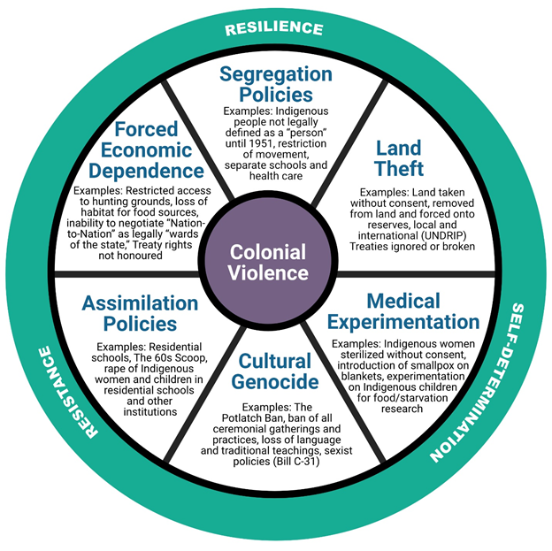
Colonial Violence and Sexual Violence
In Canada, Indigenous women, girls, Two Spirit and transgender peoples currently experience disproportionate rates of violence due to the ongoing legacies of colonialism.
Each section of this Colonial Violence Wheel provides examples of strategies, policies, and laws that have been enacted by the Canadian government to colonize and assimilate Indigenous people.
Sexual violence and colonialism are interconnected through concepts such as self-determination, autonomy and consent.
Notes:
In Canada, Indigenous women, girls, Two Spirit and transgender peoples currently experience disproportionate rates of violence due to the ongoing legacies of this history
Sexual violence and colonialism are interconnected through concepts such as self-determination, autonomy and consent.
Each section of this Colonial Violence Wheel, created by Jewell Gillies, Musgamgw Dzawada’enux, provides examples of strategies, policies, and laws that have been enacted by the Canadian government to colonize and assimilate Indigenous people.
While considering the tremendous amount of trauma Indigenous Peoples have endured for hundreds of years, it is important to note and celebrate the resiliency and resurgence of Indigenous autonomy in all aspects of their societies. From language revitalization, to advocating for justice reform on matters regarding territory resources, the medical system, social welfare and the need for trauma informed care and education in all levels of the education system.
See Section 2 of the Facilitator Guide for discussion questions about the Colonial Violence Wheel and to download the Wheel as a handout.
"Colonial Violence Wheel." Copyright, 2021, Jewell Gillies, Musgamgw Dzawada’enux. Used with permission under CC BY 4.0 License.

Slide 16
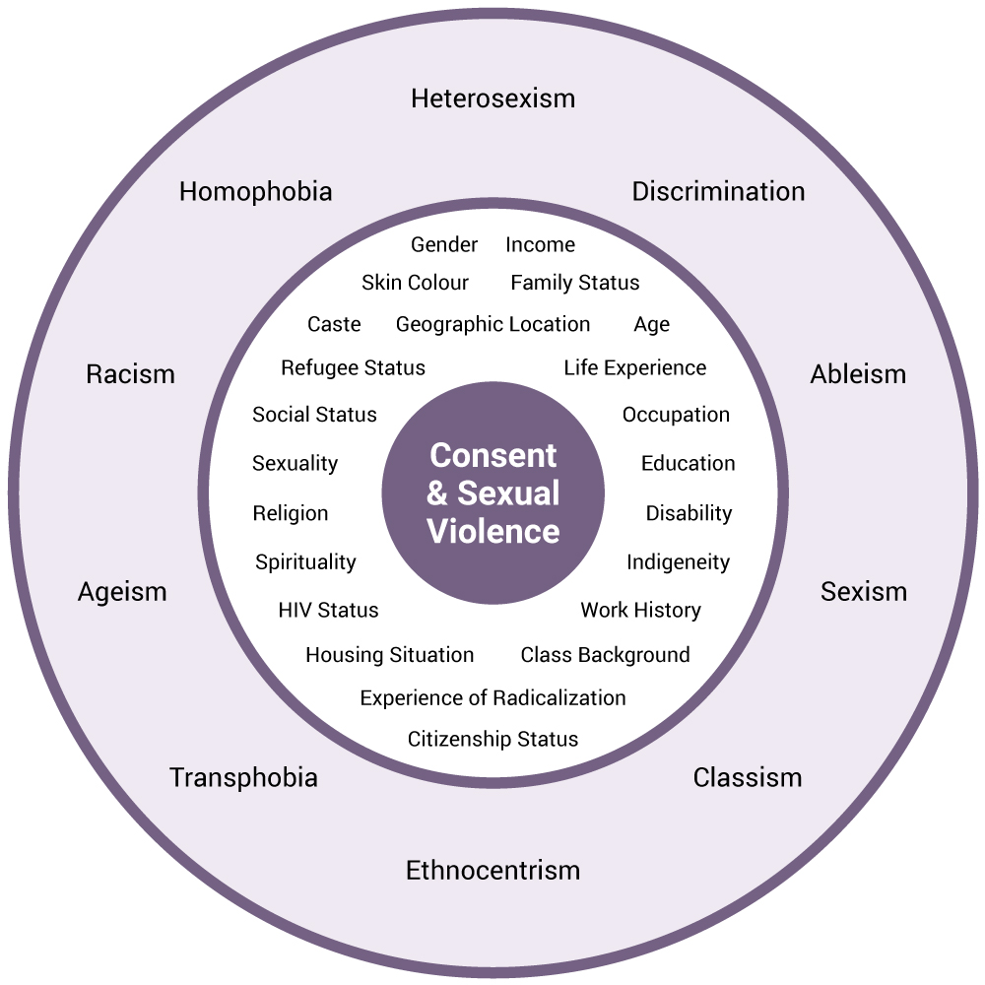
Power and Control
How is consent and sexual violence affected by power and control?
First layer: Aspects of our Identity
Second layer: Forms of violence and oppression
Notes:
8 minutes
While it is important to begin our conversation about the relationship between colonial violence and sexual violence, it’s important that we also talk about how these realities shape the experiences that of many non-Indigenous peoples as well
In addition to the relationship between colonialism and sexual violence, there are numerous hierarchies within our communities that impact both Indigenous and non-Indigenous people’s abilities to relate to one another, and that also determine what groups have access to power and privilege within our society, and which groups of people do not.
Intersectionality is a lens that can help us understand how people’s experiences of gender violence are informed by multiple forces in our society.
This wheel illustrates what intersectionality means, and how it operates within different settings. In the realm of sexual violence, it helps us to see how people’s diverse experience of violence in their personal lives are magnified by forms of structural oppression including racism, colonialism, classism, homophobia, transphobia, and ableism.
Refer to the Activities section of the Facilitator Guide: Slide 12: Sexual violence, consent, and power & control
[original graphic]

Slide 17
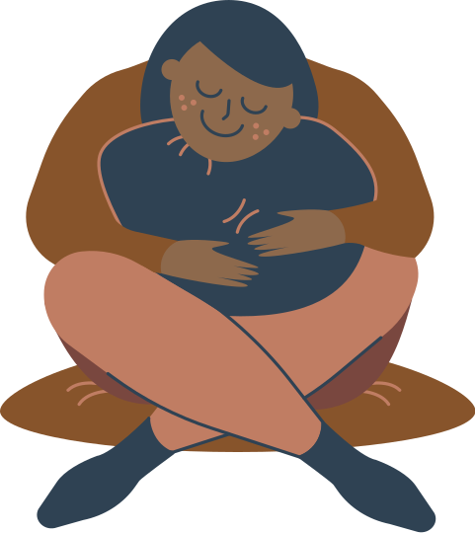

Break Time
Take time to stretch, drink some water, and breathe
Notes:
5 minutes
Slide is from SASC RTD training

Slide 18
Let’s Define Consent
[PSIs are encouraged to share the definition of sexual violence from their institutional policy]
Consent IS:
A freely given and enthusiastic yes
Ongoing, continuously discussed
Can be taken away at any time
Consent IS NOT:
Coerced or manipulated
Intoxicated or incapacitated
Notes:
3 minutes
Now that we have defined sexual violence, let’s talk about what consent means, and what it looks like in our personal lives and communities.
[Facilitators are encouraged to share the definition of sexual violence from their institutional policy]
Consent is voluntary
Consent must be voluntary and freely given without pressure, guilt, or force.
There is no voluntary consent when you are asked over and over again until you give someone the answer they want to hear; or in situations where you are made to feel guilty for giving a particular answer. If someone is being pressured or manipulated, that is not consent
There is also no voluntary consent when someone uses their power or authority to manipulate another person’s answer. For example, you cannot give consent to someone who has power or authority over you, such as an RA, TA, professor or someone you work for.
(Encouraged to connect this to PSI policy)
Legally, someone cannot consent when they are under the influence of drugs or alcohol
Consent is ongoing and continuously talked about
You must get consent before and at each stage of an sexual interaction
You must get consent when the activity changes – like going from making out to touching their bum.
You must get consent even if you have had a sexual interaction before, and even if you are dating or married.
You should always pay attention to the other person’s body language. Even if you’ve been kissing for a while, and you notice changes, it’s important to check in with them about their needs.
You should always check in with yourself, too!
Consent can be taken away at any time
Nobody owes another person intimacy or sex. Not even if you are married or dating, if they bought you dinner, or if you have had sex before.
Everybody has the right to change their mind, take away consent, and have their needs respected.
Some people might use their words to take away consent; but silence and changes in their body language are also ways to communicate that message

Slide 19
Consent and Sexual Violence in the Law
The Canadian Criminal Code says there is no consent when:
Someone says or does something that shows they are not consenting to an activity
Someone says or does something to show they are not agreeing to continue an activity that has already started
Someone is incapable of consenting to the activity, because, for example, they are unconscious
The consent is a result of a someone abusing a position of trust, power or authority
Someone consents on someone else’s behalf
(Women’s Legal Action & Education Fund, 2014)
Notes:
3 minutes (2 slides – Consent and SV in the Law; Age of Consent in Canada)
It’s important to note that there are many inadequacies with the legal definitions of sexual violence that leave many survivors out of the legal scope. For instance, there are many ways that people with disabilities are marginalized by definitions of incapability and capability to consent. (As well, women and girls with disabilities are disproportionately impacted by various forms of violence and abuse (DAWN Canada, 2019).)

Slide 20
Age of Consent in Canada
The legal age of consent in Canada is 16 years old with 3 exceptions:
12-13 - You can consent with someone less than 2 years older than you
14-15 - You can consent with someone less than 5 years older than you
18 - It is not legal for someone over 18 to have contact with someone under 18 when there is a relationship of authority, trust or dependency (West Coast Leaf, 2017)

Slide 21
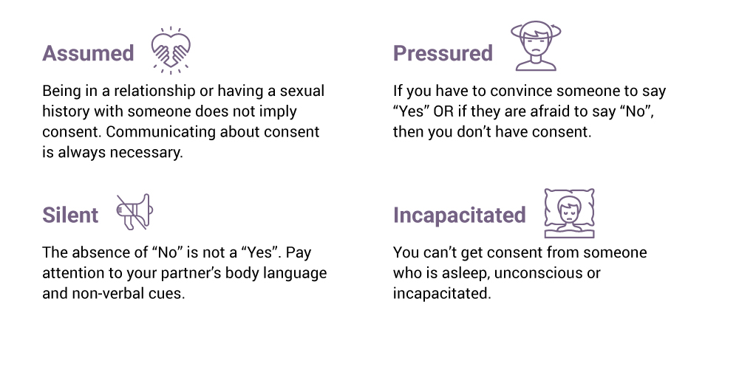
Consent Is Not:
Notes:
3 minutes
[Graphic adapted from Repairing Harm resource, April 2020, Thompson Rivers University]

Slide 22
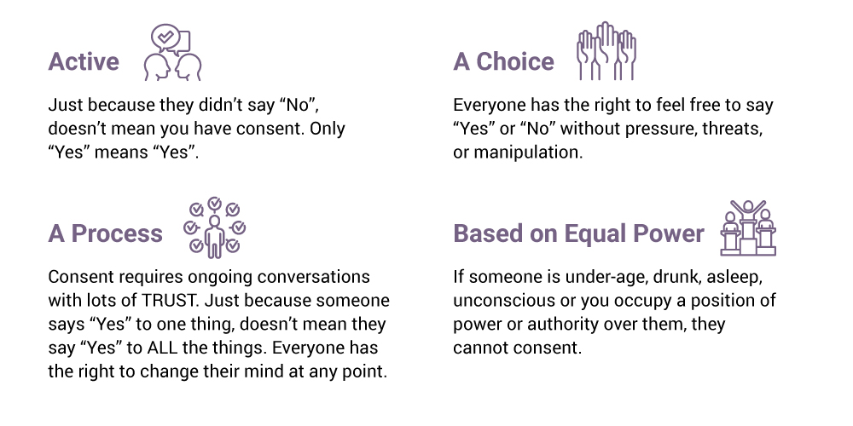
Consent Is:
Notes:
3 minutes
[Image adapted from Repairing Harm Resource (April 2020) by Meaghan Haggerty and Amber Huva from Thompson Rivers University.]

Slide 23
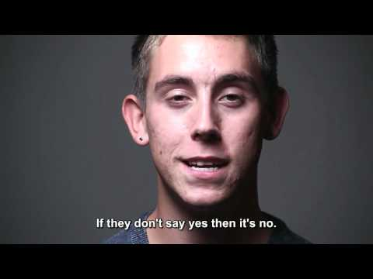
Consent: Have the Conversation (Video)
Notes:
3 minutes
Note to facilitators: Choose one video depending on time, audience, etc.]
This and the following three videos can be a “conversation starter” about definitions of consent, asking for and giving consent, and building communities of consent. Provide a content warning to learners. While the videos use safe language to discuss sexual violence and consent, acknowledge that it still might be trauma reminder for some people.
F2F: “We encourage you to take care of yourself and step aside if that feels safe or reach out to the facilitator during the upcoming break for a check-in.”
Online: “We invite you to take care of yourself and choose to no watch the video by silencing it or looking away from your computer screen for the next few minutes.”
Video Options:
“Consent: Have the Conversation” (https://www.youtube.com/watch?v=_XiMtPFJigc). This video was created by the University of Carleton and contains an encouraging, diverse and assertive message promoting the practice of consent. (2012, 1:36)
“Let’s Talk About Consent” (https://youtu.be/TBFCeGDVAdQ). Written, produced, and directed by NYU students and alumni, this short video reflects 18 hours of interviews with students and recent grads at NYU and across New York City who shared what consent means to them, and the importance of starting a brave conversation on campus (2014, 3:43)
“Consent.” (https://youtu.be/7SWFM0NMhvw). This animated video developed by Thompson Rivers University defines consent and describes consent in both everyday and sexual relationships (2018, 3:01).
“Tea Consent” (https://youtu.be/oQbei5JGiT8). This viral video asks viewers to think about consent as a cup of tea. (2014, 2:50)

Slide 24
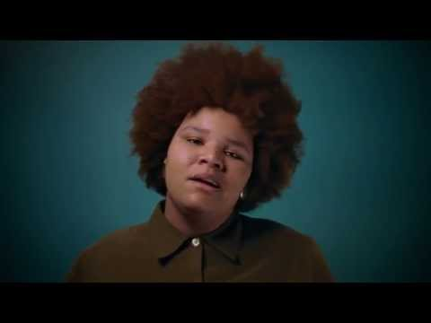
Let’s Talk About Consent (Video)
Notes:
3 minutes
Each of these short videos can be a “conversation starter” about definitions of consent, asking for and giving consent, and building communities of consent. Provide a content warning to learners. While the videos use safe language to discuss sexual violence and consent, acknowledge that it still might be trauma reminder for some people.
F2F: “We encourage you to take care of yourself and step aside if that feels safe or reach out to the facilitator during the upcoming break for a check-in.”
Online: “We invite you to take care of yourself and choose to no watch the video by silencing it or looking away from your computer screen for the next few minutes.”
Video Options:
“Consent: Have the Conversation” (https://www.youtube.com/watch?v=_XiMtPFJigc). This video was created by the University of Carleton and contains an encouraging, diverse and assertive message promoting the practice of consent. (2012, 1:36)
“Let’s Talk About Consent” (https://youtu.be/TBFCeGDVAdQ). Written, produced, and directed by NYU students and alumni, this short video reflects 18 hours of interviews with students and recent grads at NYU and across New York City who shared what consent means to them, and the importance of starting a brave conversation on campus (2014, 3:43)
“Consent.” (https://youtu.be/7SWFM0NMhvw). This animated video developed by Thompson Rivers University defines consent and describes consent in both everyday and sexual relationships (2018, 3:01).
“Tea Consent” (https://youtu.be/oQbei5JGiT8). This viral video asks viewers to think about consent as a cup of tea. (2014, 2:50)

Slide 25
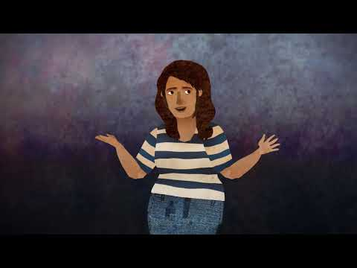
Consent (Video)
Notes:
3 minutes
Each of these short videos can be a “conversation starter” about definitions of consent, asking for and giving consent, and building communities of consent. Provide a content warning to learners. While the videos use safe language to discuss sexual violence and consent, acknowledge that it still might be trauma reminder for some people.
F2F: “We encourage you to take care of yourself and step aside if that feels safe or reach out to the facilitator during the upcoming break for a check-in.”
Online: “We invite you to take care of yourself and choose to no watch the video by silencing it or looking away from your computer screen for the next few minutes.”
Video Options:
“Consent: Have the Conversation” (https://www.youtube.com/watch?v=_XiMtPFJigc). This video was created by the University of Carleton and contains an encouraging, diverse and assertive message promoting the practice of consent. (2012, 1:36)
“Let’s Talk About Consent” (https://youtu.be/TBFCeGDVAdQ). Written, produced, and directed by NYU students and alumni, this short video reflects 18 hours of interviews with students and recent grads at NYU and across New York City who shared what consent means to them, and the importance of starting a brave conversation on campus (2014, 3:43)
“Consent.” (https://youtu.be/7SWFM0NMhvw). This animated video developed by Thompson Rivers University defines consent and describes consent in both everyday and sexual relationships (2018, 3:01).
“Tea Consent” (https://youtu.be/oQbei5JGiT8). This viral video asks viewers to think about consent as a cup of tea. (2014, 2:50)

Slide 26

Consent Tea (Video)
Notes:
3 minutes
Each of these short videos can be a “conversation starter” about definitions of consent, asking for and giving consent, and building communities of consent. Provide a content warning to learners. While the videos use safe language to discuss sexual violence and consent, acknowledge that it still might be trauma reminder for some people.
F2F: “We encourage you to take care of yourself and step aside if that feels safe or reach out to the facilitator during the upcoming break for a check-in.”
Online: “We invite you to take care of yourself and choose to no watch the video by silencing it or looking away from your computer screen for the next few minutes.”
Video Options:
“Consent: Have the Conversation” (https://www.youtube.com/watch?v=_XiMtPFJigc). This video was created by the University of Carleton and contains an encouraging, diverse and assertive message promoting the practice of consent. (2012, 1:36)
“Let’s Talk About Consent” (https://youtu.be/TBFCeGDVAdQ). Written, produced, and directed by NYU students and alumni, this short video reflects 18 hours of interviews with students and recent grads at NYU and across New York City who shared what consent means to them, and the importance of starting a brave conversation on campus (2014, 3:43)
“Consent.” (https://youtu.be/7SWFM0NMhvw). This animated video developed by Thompson Rivers University defines consent and describes consent in both everyday and sexual relationships (2018, 3:01).
“Tea Consent” (https://youtu.be/oQbei5JGiT8). This viral video asks viewers to think about consent as a cup of tea. (2014, 2:50)

Slide 27
Reflection
What does consent mean to you?
Any reflections or thoughts from the video that you would like to share?
Notes:
8 minutes
Facilitate a large group discussion with learners. Ask for their reflections on consent and what it looks like when initiating relationships, friendships, flirting, online dating, dating, kissing, in sexual connections and so on…
Make connections between learners’ responses and the themes in this training - how can learners continue to keep practicing consent or engaging in a consent based culture.
This activity will allow for everyone's participation, and should elicit specific details about what the individual understands or does not understand about what is consent
Online: Have this activity presented in the white board so people can type if they feel shy or have a limitation to chat/conversation.
F2F: Have box and sticky notes of the same color ready for people to drop their questions and comments to this box in case they feel much safer that way.

Slide 28
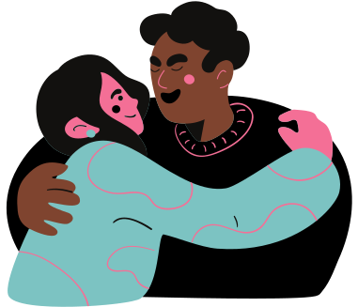
Social Scripts
What does society tell us about asking for and giving consent?
Social scripts are expectations about how we should act in certain situations
Dating, sex, and relationship scripts often perpetuate stereotypes
Notes:
We’ve started off today exploring what consent means in a large context, and now we will look at how power dynamics and consent play out in our everyday lives and relationships
Like in a movie or TV show, scripts are a set of expectations about how we should act in social situations.
Social scripts can be helpful when we first visit or move to a new community to help us navigate situations we might not be familiar with. But there are also social scripts that might not help us as much. Instead, it can create some challenges for us – especially when we want to go against the script.
In addition, many of these scripts are based on stereotypes - socially perpetuated ideas about how certain groups of people should behave, and who deserves to be heard or not in different situations
In many cases, these scripts impact our ability to say or to hear “no”
[Facilitators are encouraged to use examples from pop culture, for instance, as examples of a place where we might learn dating scripts. Adapt examples so they are relevant to audience; the discussion should focus on how power and control show up in social norms portrayed around dating and sex]
[image is from SASC RTD presentation]

Slide 29

Building Communities of Consent
Let’s think about the different environments in our communities:
How do we practice consent when we invite someone out? How do we respond if they reject our invitation?
How do we respond to an invitation that we don’t want to accept?
Notes:
2 mins
In order for us to build communities of consent and relationships of consent with one another, it’s really important to learn about and practice our own boundaries.
This is also about developing different scripts that we can keep in our back pocket to navigate future situations
Boundaries are about how we know what we want to say no and yes to and how we communicate these with one another. This includes our ability to receive a no from someone else
[images from Supporting Survivors presentation]

Slide 30

Activity: Scenarios
Let’s practice different scenarios for asking and giving consent:
Smiling and then saying “no”
“Sorry, I have a partner”
Changing the subject
Run away, ghost
Notes:
Please refer to the Activities section of the Facilitator Guide: Building Communities of Consent
“There are many opportunities to practice consent in our everyday lives and hopefully after this activity you will have some skills you can take with you, to have in your back pocket to reference and practice with others. activity is a learning and practice opportunity to obtain consent and to practice setting boundaries”
This activity can be done in groups of 3-5.
Person 1: Asks for consent.
Person 2: Practices setting a boundary or saying “no.”
Person 3: Witnesses the interaction between Person 1 and 2 and offers feedback, e.g., what went well or suggestions for alternate approaches.
If there are more than three people in a group, learners can rotate through the different roles as they move through the scenarios.
Give learners the opportunity to add details to the scenarios to make them more relevant to their context.
[slide From UBC Jump start students 2020]

Slide 31

Scenario 1
How would you respond if a stranger on the street asked you on a date and you were not interested?
Notes:
Image source: https://pixabay.com/vectors/city-town-cityscape-building-urban-4791269/

Slide 32
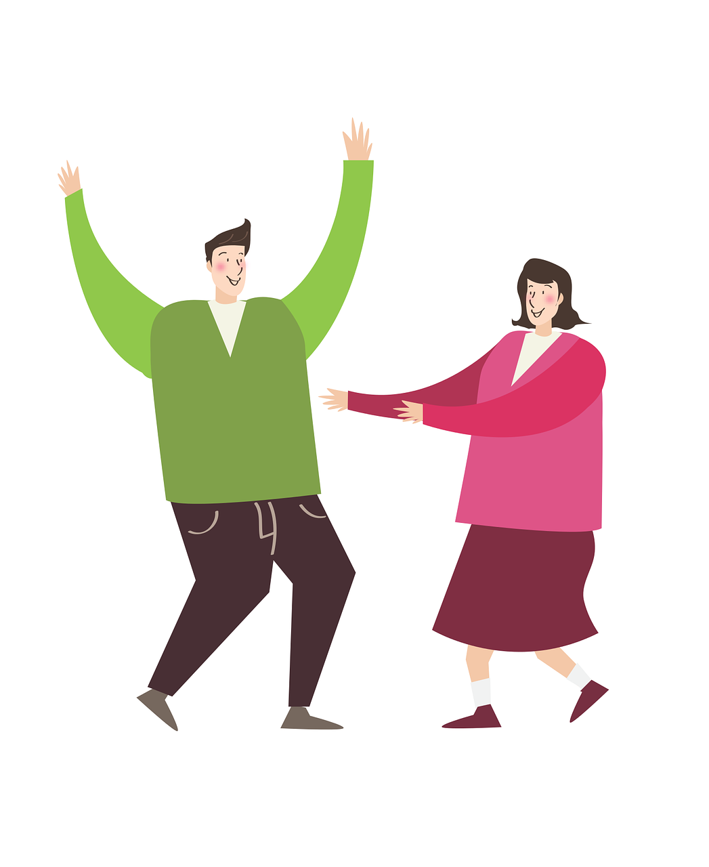
Scenario 2
How would you respond if a stranger at a club or party asked you on a date and you were not interested?
Notes:
Image source: https://pixabay.com/illustrations/man-women-couple-joy-dancing-2956377/

Slide 33

Scenario 3
How would you respond if someone at your workplace or in a class/lab asked you on a date?
Notes:
Image source: https://pixabay.com/illustrations/school-education-kids-people-3159205/

Slide 34

Scenario 4
How would you respond if someone on social media or a dating app asked you out on a date?
Notes:
Image source: https://pixabay.com/vectors/video-conference-online-office-5314516/

Slide 35

Large Group Debrief
How was the activity?
Any learnings and insights?
Notes:
Please refer to the Activities section of the Facilitator Guide: Community actions towards the elimination of sexual violence

Slide 36

Reflection: Actions To Take
How do we continue from here?
Personal actions towards solidarity and a practice of consent
Notes:
Write learners’ comments and answers on a new document slide or live-share with learners.
Image source: https://pixabay.com/vectors/people-boy-together-young-children-1973918/

Slide 37
Community Actions
What community actions contribute towards the elimination of
sexual violence?

Slide 38
Resources for Survivors of Sexual Violence
Examples: Student Support Services at your institution , Student Union Resources, Indigenous Support Services, Multicultural organizations including low barrier ones (i.e., not all students or folks may be able to access Immigration sponsored orgs), LGBTQ2SIA+ dedicated Two-Spirit on & off campus support groups, Accessibility supports on- and off-campus , Sexual Health resources, Anti-violence organizations in community, Victim services and law enforcement, suicide emergency line, mental health & wellness ideas (for example print out colouring pages, etc.), who can they follow up with after this training in case they have questions etc.?
Notes:
Would recommend that facilitators end each presentation with a slide containing campus and local resources for survivors of sexual violence, including hours and contact information. It is also important that these include Indigenous and multicultural organizations
Image source: https://pixabay.com/illustrations/women-people-woman-smile-portrait-5753058/

Slide 39
References 1
Burczycka, M. (2020). Students’ experiences of unwanted sexualized behaviours and sexual assault at postsecondary schools in the Canadian provinces, 2019. Canadian Centre for Justice and Community Safety Statistics. https://www150.statcan.gc.ca/n1/en/pub/85-002-x/2020001/article/00005-eng.pdf?st=2pX9QRnP
Carleton University. (2012). Consent have the conversation [Video]. Retrieved from: https://www.youtube.com/watch?v=_XiMtPFJigc
Crenshaw, K. W. (1991). Mapping the Margins: Intersectionality, Identity Politics, and Violence against Women of Color. Stanford Law Review, 43(6), 1241–1299. Retrieved from https://www.jstor.org/stable/pdf/1229039.pdf?refreqid=excelsior%3Ac82d7ef48b045700f315cefe60968d78
Notes:
Note – These Reference slides have been created with 24 point font, which is the minimum necessary to meet accessibility guidelines for visual presentation. If the slides will not be displayed to the audience, but shared after the presentation, facilitators may want to consolidate the references onto fewer slides with smaller font size.

Slide 40
References 2
Disabled Women’s Network of Canada (DAWN). (2019). More Than a Footnote: A Research Report on Women and Girls with Disabilities in Canada. Retrieved from https://www.dawncanada.net/news/mtafreport/
DeKeseredy, W.S. (2011). Violence Against Women: Myths, Facts, Controversies. Toronto, ON: University of Toronto Press.
King, T. (1990). All My Relations: An Anthology of Contemporary Canadian Native Prose. McClelland & Stewart.
Konsmo, E. M., & Pacheco, A. M. K. (2016). Violence on the Land, Violence on Our Bodies. Retrieved from http://landbodydefense.org/uploads/files/VLVBReportToolkit2016.pdf

Slide 41
References 3
Martin, C. M., & Walia, H. (2019). Red Women Rising: Indigenous Women Survivors in Vancouver’s Downtown Eastside. Retrieved from http://dewc.ca/wp-content/uploads/2019/03/MMIW-Report-Final-March-10-WEB.pdf
Palmater, P. (2016). Shining Light on the Dark Places : Addressing Police Racism and Sexualized Violence against Indigenous Women and Girls in the National Inquiry. Canadian Journal of Women and the Law, 28(2), 253–284. https://doi.org/10.3138/cjwl.28.2.253
National Inquiry into Missing and Murdered Indigenous Women and Girls. (2019). Reclaiming Power and Place: The Final Report of the National Inquiry into Missing and Murdered Indigenous Women and Girls. https://www.mmiwg-ffada.ca/final-report/#:~:text=Women%20and%20Girls-,Reclaiming%20Power%20and%20Place,women%2C%20girls%20and%202SLGBTQQIA%20people

Slide 42
References 4
Statistics Canada (2017). Self-reported sexual assault in Canada, 2014. Retrieved from https://www150.statcan.gc.ca/n1/pub/85-002-x/2017001/article/14842-eng.htm
Truth and Reconciliation Commission. (2015). Canada’s Residential Schools: The Legacy (Vol. 5). Montreal: McGill-Queens University Press.
West Coast Leaf. (2017). Is that Legal? What the law says about online harassment and abuse. West Coast Leaf Education and Action Fund. Retrieved from: http://www.westcoastleaf.org/wp-content/uploads/2020/11/Is-That-Legal_Oct-2020-corrected.pdf
Women’s Legal and Education Action Fund. (2014). The Law of Consent in Sexual Assault.
Retrieved from: https://www.leaf.ca/news/the-law-of-consent-in-sexual-assault/

Slide 43
Images
Original graphics for this presentation were generously shared by:
Alma Mater Society of University of British Columbia Sexual Assault Support Centre. (2020). Responding to Disclosures Training.
University of British Columbia Sexual Violence Prevention and Response Office. (2020). Jump Start Student Training.
Please see the Creative Commons/Acknowledgements section of the Facilitator Guide that accompanies this slide deck for more information.
“Ice-Capped Mountain” Photo by Mads Schmidt Rasmussen on
Unsplash https://unsplash.com/photos/xfngap_DToE
For all other images, see the facilitator notes of individual
slides for more information
Notes:
Image source: https://pixabay.com/illustrations/girls-unique-diversity-tolerance-4960165/

Slide 44
Acknowledgments 1
Consent and Sexual Violence Training and Facilitator Guide: Preventing and Responding to Sexual Violence in BC Post-Secondary Institutions was collaboratively created as part of the BCcampus Sexual Violence and Misconduct (SVM) Training and Resources Project. The project was led by BCcampus and a working group [CoP1] of students, staff and faculty from B.C. post-secondary institutions. It is licensed under a Creative Commons Attribution 4.0 International license, except where otherwise noted.
This training and associated facilitation guide is an adaptation of Jumpstart Students (2019 & 2020) copyright © held by the University of British Columbia Okanagan. It was shared under a Memorandum of Understanding with BCcampus to be adapted as an open education resource (OER) for the B.C. post-secondary education sector. It is the result of the BCcampus (SVM) Training and Resources Project funded by the B.C. Ministry of Advanced Education and Skills Training (AEST).

Slide 45


Acknowledgements
This adaptation includes the following changes and additions which are © 2021 by the SVM Training Development Team [Dev1] and are licensed under a CC BY 4.0 Licence.
The enhancements made to this resource were informed by the Evaluating Sexualized Violence Training and Resources: A Toolkit for B.C. Post-Secondary Institutions developed by the SVM Training and Resources working group [CoP1].
Please see the Facilitator Guide that accompanies this slide deck for more information about the development of this resource.

