Slide 1
Money Moksha
Money makes the world go around, the world go around, the world go around. Money makes the world go around of that we can be sure - Cabaret
www.moneymoksha.com

Slide 2
Rocket Scientists’ Guide to Money and the Economy

Slide 3
Money Moksha
Money
Moksha
The bane of our existence
The cause of our problems
The end of humanity
The tool of our salvation
Extrication of Consciousness from samsara (worldly illusion)
Freedom from ignorance and delusion
Self-realization/Self-knowledge/Absolution/Liberation

Slide 4
What is Money?
When you ask, most people define money by how they use it
Most people use money to buy things
So, most people define money as something they use to buy things
But this practical definition of money is inadequate
It Does not capture the essence of money
$$
In order to understand money, must understand “Economic Exchange

Slide 5
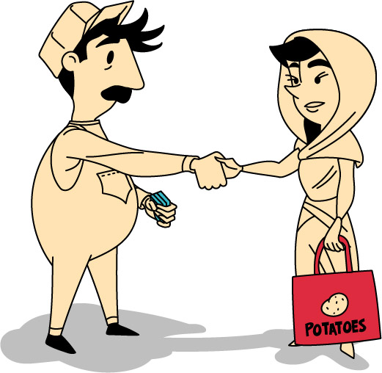
Economic Exchange
Money does allow you to buy things, but Money allows you to do so much more
In order to understand better what money is, understand money in reality
money really is a means of exchange.
When money changes hands, we are engaged in a process of economic exchange
ECONOMIC EXCHANGE is important!

Slide 6
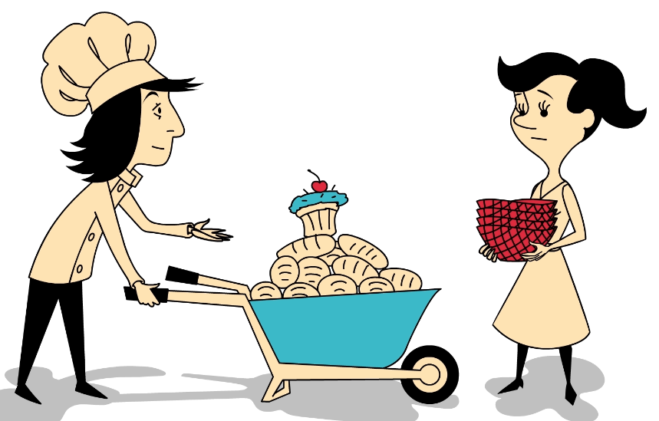
Better Life/Better World Comes From Exchange
I make bread, You make Pots,
I Fish, you build houses
By working, we build, create, survive
In order to live better, we Exchange the things we make
Through Exchange WE create the world
Through Exchange We Have a better life

Slide 7
Question? What are WE Exchanging
Looks like we are exchanging products (pots/fish) or services (massage/carpentry), and true
But not really
Exchanging more than simple products and services
What we really exchanging is our LABOUR TIME
I work and build or serve I exchange my labour for something else

Slide 8
Labour Exchange ➢ Key To Human Life
Human Labour
Labour what makes us human
Labour what makes us Divine
Work in Fields, blacksmith, pottery, children, carpentry, build, explore, Expand. Manifest. Create
If we don’t work, if we don’t labour, we don’t survive
Labour Problems
only so much time in a day
Only so many things we can do for ourselves
Can Only be good at so many things
By ourselves, cannot create the world as it is -> Shared labour required
Collective exchange of products and service a necessity
But

Slide 9
Most Basic form of Labour Exchange iS Barter
With Barter You exchange the products you Make
If You bake bread and I fish, I give you fish for your bread
We barter products and services
Do that Roughly equivalent to the time it takes for each.
If it takes eight hours to make five loaves, I give you eight hours worth of fish

Slide 10
Problems With Barter
Barter is great, but inefficient
Have to figure out the “Exchange rate” each time how much to trade
Have To need the others product
Spacial/temporal limitations on Exchange. Person you exchange with has to be in front of you for exchange to work

Slide 11
Enter Money
Money is a “medium of Exchange”
Money allows us to exchange efficiently
Standardized and easy to understand Units
Don’t have to want the other’s products, just exchange money
Don’t have to be in front of the person, just exchange money
If I want a stereo or cloths, I can just give you money to exchange. You can then use Money to buy whatever you want
Fast, Efficient, Global
Question is, what is money, Exactly?

Slide 12
Class Work Time
Pause and Discuss with Class.
Ask class what they think money is, record their answers
View Money Moksha Video,
pause Video at 2:50

Slide 13
Money = Labour Power
Labour!!
Not Expertise
Not Services
Not products
Not Goods

Slide 14
Money = Abstracted Labour
More to the Point
Work in exchange for money
Work 8 hours, get paid certain amount of money for that work
Take that money and trade it for somebody else’s work
Money = Work
Money = Labour Time
Money = Abstracted Labour

Slide 15
Money as Abstracted Labour
A solution to the problems of Social Exchange
Allows Efficient Exchange
Trade Efficiently,
Trade globally,
trade constantly,
Allows Specialization,
Instead of having to build my own house, grow my own food, can specialize.
Focus all time on being a carpenter, farmer, engineer
More efficient production
Economies of Scale
Growth of Expertise (be a better carpenter/engineer if that’s al you do with your labour)
Gives society ability to support “non productive” members -> New Occupations Emerge
Philosopher
Musician
Professor
Rocket Scientst

Slide 16
Money = Total Human Awesomeness
Money Gives us the world we live in.
Without Money, None of anything we take for granted would be possible
But, as great as money is, one major problem

Slide 17
The Problem with Money
Problem with Money is Accumulation
Money easy to accumulate
Money tempting to accumulate
Accumulation of Money Highly Addictive

Slide 18
Addicted to Accumulation
Addiction
And people do get addicted, easily
Begin to accumulate, can’t stop
Do anything they can to accumulate more
And Have Succeeded
64 people on this planet own ½ of the world’s wealth, while billions barely subsist
Warren Buffet calls it “class war” but its really a global addiction
“There’s class warfare, all right, but it’s my class, the rich class, that’s making war, and we’re winning.
Warren Buffet, Richest Man on Earth NY Times, November 11, 2006

Slide 19
Class Work Time
Besides fantastic levels of wealth and inequality, ask class to Think about/anticipate what problems might be. Take notes from their discussion to compare
View Money Moksha Video,
Pause Video at 6.08

Slide 20
Accumulation Addiction Leads to Problems/Global Crises
Run up Against Ecological Limits of the Planet
Global Warming -> floods, Hurricanes, Droughts
Abuse/exploitation of workers
Fast Fashion (http://truecostmovie.com/)
Killer Coke (http://killercoke.org/)
Free Trade Zones
Financial Catastrophes
Debt/depression/recession/austerity
Global Meltdown
Violence/refuges/war/fascist governments

Slide 21
Class Work Time
Pause and Discuss with Class (optional).
Ask Class to think about/anticipate possible solutions.
View Remainder of Money Moksha Video,

Slide 22
Solutions
Education
Debt Jubilee
Limit/End Accumulation
Spiritual/Humanist Revolution

Slide 23
Credits
Funding
Support
This project was funded by the Alberta Open Educational Resources (ABOER) Initiative; made possible through an investment from the Alberta government.
This project was made possible by the generous support of Athabasca University

