Slide 1




CAPACITY TO CONNECT:
Supporting Students’
Mental Health and Wellness

Slide 2

Territory Acknowledgement

Slide 3
Our Goal
Discuss the role you can take in supporting students’ mental health.
Give you basic tools for:
  Recognizing the signs of distress
  Responding with empathy
  Referring students to campus resources

Slide 4
Presentation Objectives
We hope that by the end of this presentation, you will be able to:
Describe what mental health is.
Recognize the different ways students may express distress.
Respond to a student with a mental health concern in an empathetic way.
Refer a student in distress or illness to appropriate resources.
Explain the need for boundaries when supporting students in distress.

Slide 5
Support and Self-Care
Take any actions you need for your own well-being:
  Pause
  Ground yourself
  Take a break or leave (give us a thumbs up as you’re leaving so we know you’re okay)
Share only if you are comfortable.
If you need further support, reach out after the session.

Slide 6
Understand Your Role
Because you interact with students frequently, you are often in a position to recognize when a student may be in distress.
You are not expected to be a counsellor.
You can be a supportive person and connect a student to campus services and resources, such as counselling.

Slide 7
Practical Information
Presention is two hours long.
Questions and reflections are encouraged.
Handouts will be available at the end.
If online, remember to use the mute button.
If online, leaving your camera on is optional.

Slide 8
What Is Mental Health and Wellness?

Slide 9
One Definition of Mental Health
Mental health is the capacity of every individual to feel, think, and act in ways that enhance their ability to enjoy life and deal with challenges.
It is a positive sense of emotional and spiritual well-being that respects the importance of culture, equity, social justice, interconnections, and personal dignity.
Source: Public Health Agency of Canada. (n.d.). Mental health and wellness. https://cbpp-pcpe.phac-aspc.gc.ca/public-health-topics/mental-health-and-wellness

Slide 10
Wellness Wheel
The Wellness Wheel aligns with an Indigenous perspective that views individuals holistically.
Wellness is a state of balance.
Each dimension of wellness is interconnected.
All dimensions are equally important to finding balance.

Slide 11
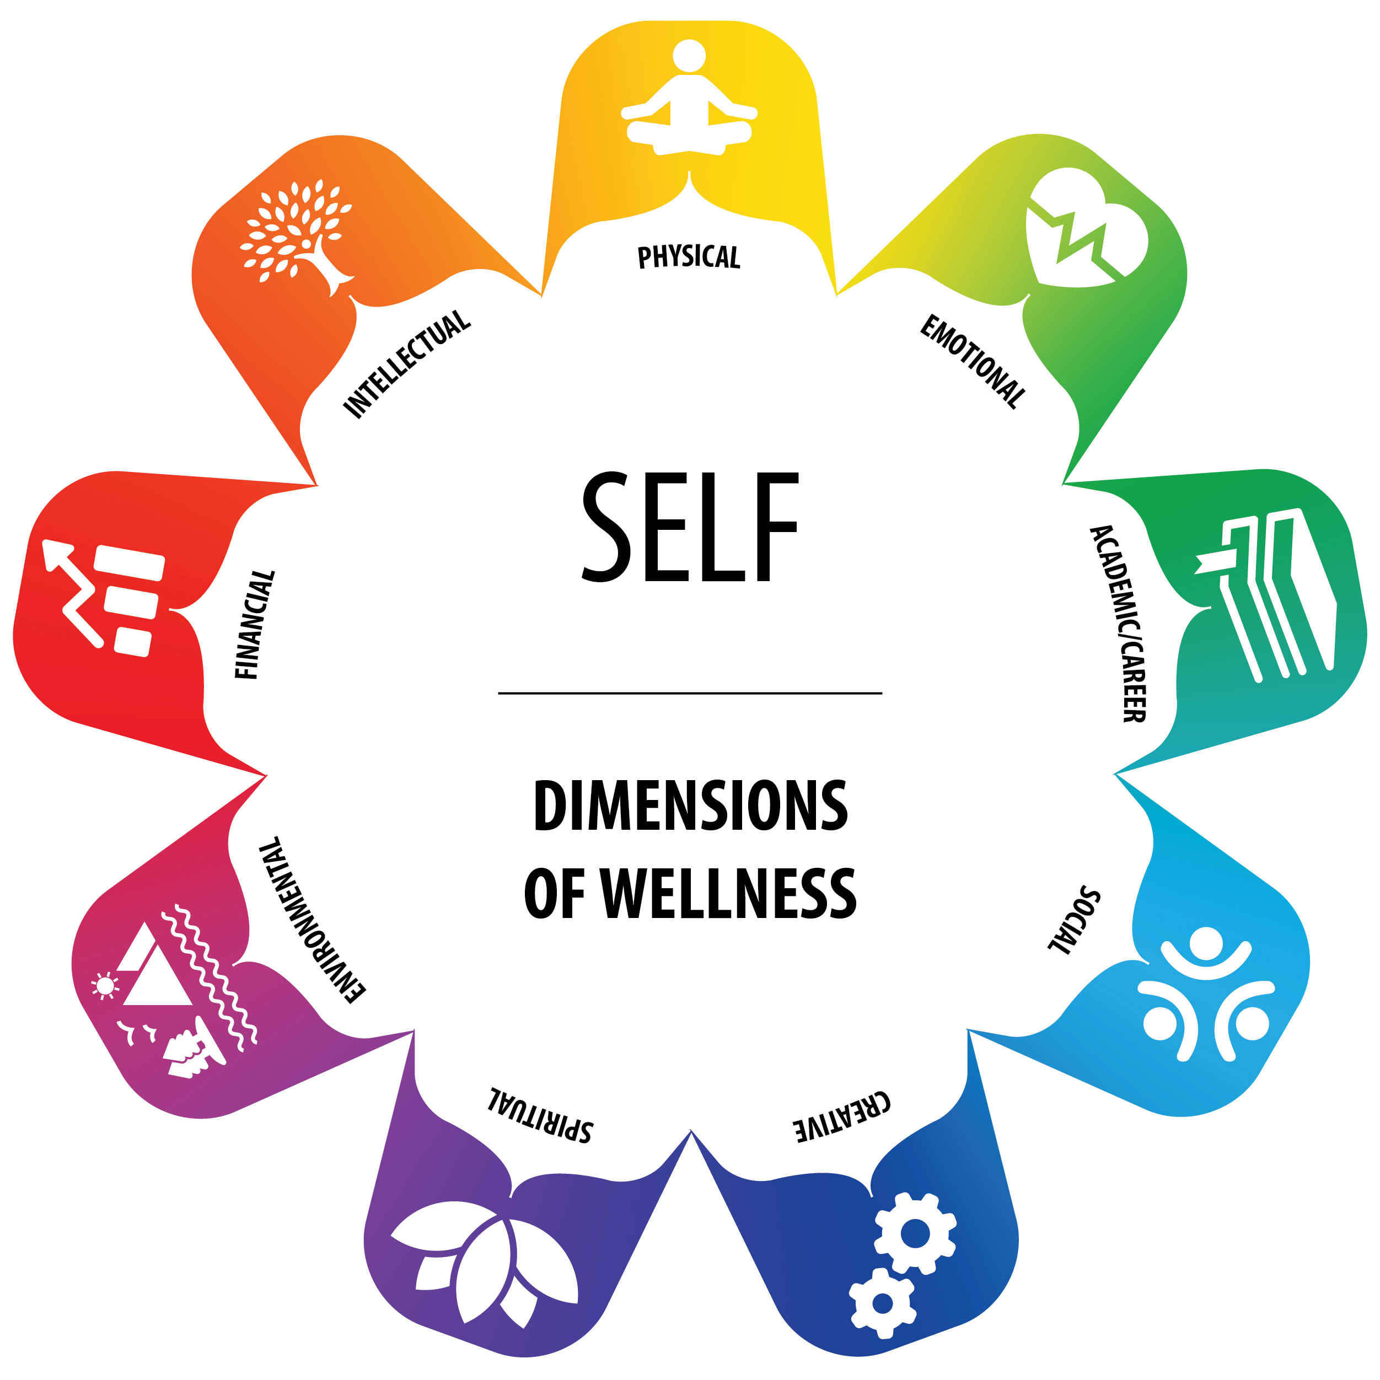
Wellness Wheel

Slide 12
What Is Resilience?
Being able to adapt to challenges and setbacks.
Finding ways to shift back toward balance and mental wellness.
Noticing when stress appears and taking
proactive steps to manage it.
The Wellness Wheel can be a guide.
It helps us recognize imbalance and our
resiliency.

Slide 13
Small Group Activity
Consider one or more aspects of the Wellness Wheel.
If you feel comfortable, discuss:
  What stressors might fall under this part of the wheel?
  How might students behave when they are facing these stressors?
  What strengths and resiliency might students show?
We’ll debrief in about 5 minutes.

Slide 14
Mental Health and Mental Illness
Mental Health
Capacity to think, feel and act in ways that enhance our ability to:
Enjoy life
Deal with challenges
Mental Health Issues
Diminished capacities (cognitive, emotional, attentional, etc.) that interfere with:
Enjoyment of life
Interactions with society and our environment
Mental Illness
Conditions that affect a person’s thinking, feeling mood, or behaviour including:
Depression
Anxiety
Post-traumatic stress disorder

Slide 15
Mental Health and Mental Illness
People living with mental illness can have good mental health and be flourishing in their lives.

Slide 16
Corey Keyes’ Dual Continuum Model
Good mental health
Flourishing/thriving
with illness
Flourishing/thriving
without illness
Mental
illness
No mental
illness
Languishing/surviving
with illness
Languishing/surviving
without illness
Poor mental health

Slide 17
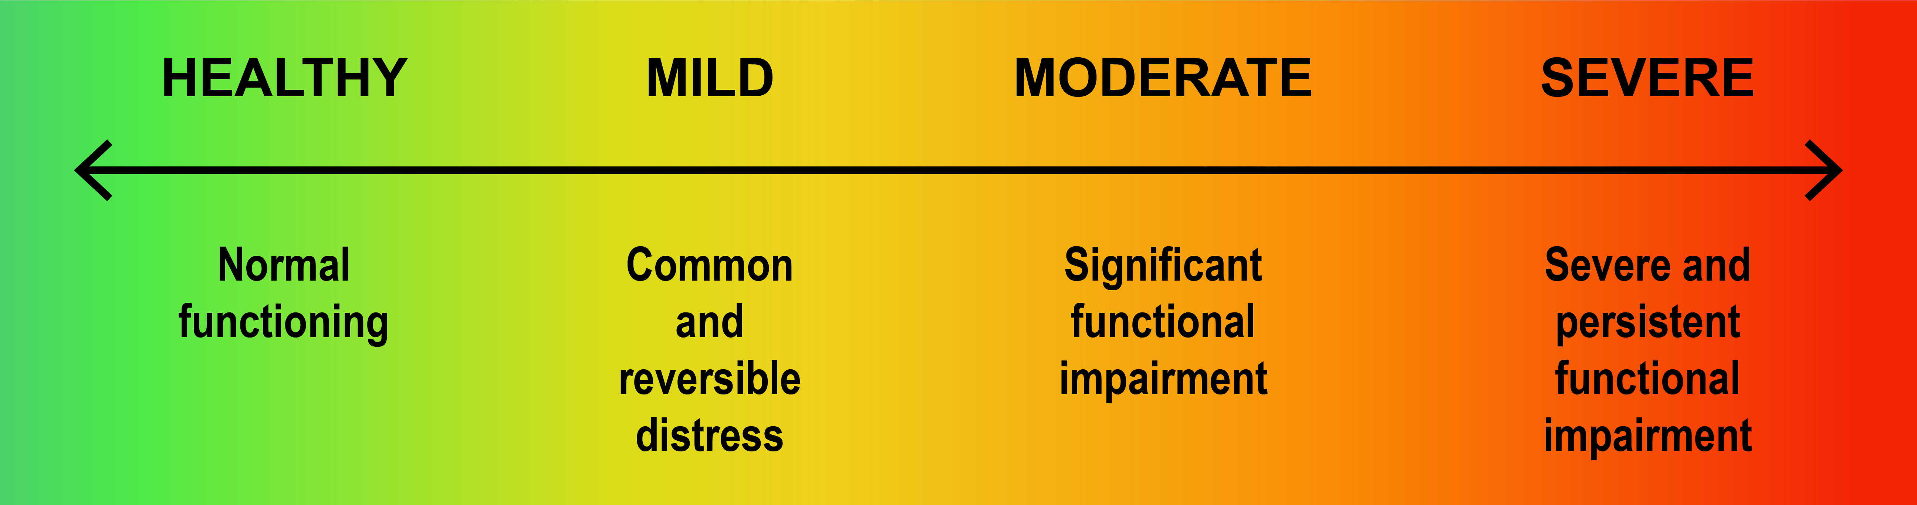
Mental Health Continuum

Slide 18
Marginalized Groups and Mental Health
Students may face inequality, discrimination, and violence because of race, sexual orientation, or disability. This can affect mental health.
We can work to provide a culturally safe space for all students including those who are:
  Indigenous
  New to Canada (international students)
  LGBTQ2S+
  Living with a disability
  From racialized communities

Slide 19

Reflection
As you think about students you work with, what stresses might be specific to certain groups?

Slide 20
Did You Know . . .
In any given year,
1 in 5 people experience a mental health problem or illness.
But only 1 in 3 people who experience a mental health problem or illness receive help or treatment.
Source: Mental Health Commission of Canada. (2012). Changing directions, changing lives: The mental health strategy for Canada. Calgary, AB.

Slide 21
Post-Secondary Students
In 2019, a survey of Canadian post-secondary students showed:
51% felt depressed
69% felt overwhelming anxiety
16% seriously considered suicide
Source: American College Health Association. (2019). American College Health Association-National College Health Assessment II: Canadian Group Data Report Spring 2019.

Slide 22
Reflection
Do any of these statistics surprise you?
What thoughts have come up for you so far as you think about the prevalence of mental health issues?

Slide 23
The Three Rs Framework
Recognize Respond Refer

Slide 24
Recognize
A noticeable change in a student’s words, actions, body language.

Slide 25
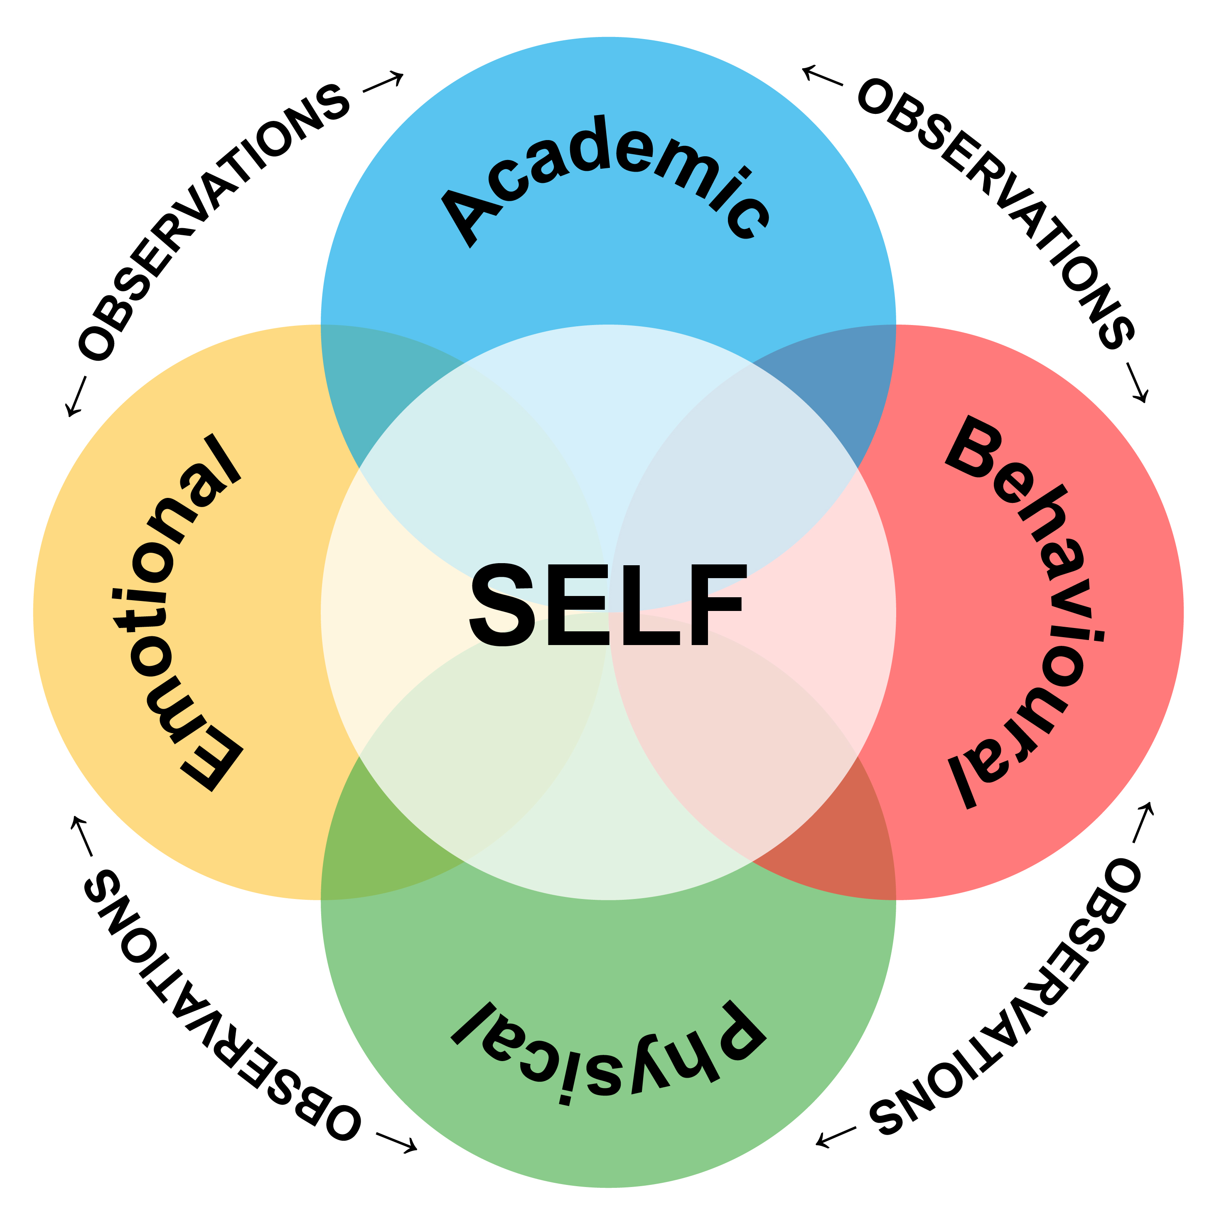
Recognizing Signs of Distress

Slide 26
What About Suicide?

Slide 27
Reflection: Responding to Distress
Think of a time you were mildly or moderately distressed.
What did you need?

Slide 28

Empathetic Responses
Video:
Empathy
in Action

Slide 29
Video Reflection
What stood out for you about the video?
Is there anything you like to add to the conversation about what would (or wouldn’t) be a supportive response?

Slide 30
Ideas for Empathetic Responses
Give the student your complete attention.
Listen without judgment.
Try using “I” statements. (E.g., I’ve noticed you haven’t handed in the last two assignments, and I’m concerned.)
Acknowledge their thoughts and feelings with compassion.
Repeat their statements to clarify and ensure you understand.
Let them know you are concerned and want to help them find the right resources.

Slide 31
Asking About Suicide
What are your concerns, worries, or fears about asking a student if they are thinking about suicide?

Slide 32
If a Student Is Thinking About Suicide
Ask if they want to talk about it.
Ask if there is anything you can do and offer to help find support.
Be non-judgmental and empathetic.
Do not minimize the feelings expressed by the student.
Do not be sworn to secrecy. Seek support.
Do not debate with the student or use clichés.
In an acute crisis, take the student to counselling or call a crisis line.
Do not leave the student alone until help is provided.

Slide 33
Referring Students for Help
Counselling services
Campus security
Indigenous student centre
Health/medical services
International student services
Accessible learning centres
Financial aid

Slide 34
Provincial Mental Health Resources
BC Suicide Line: 1-800-784-2433
Mental Health Support Line: 310-6789
Here2Talk: 1-877-857-3397 (a 24-hour phone and chat counselling support for B.C. post-secondary students).

Slide 35
If a Student Refuses Help
Consider student safety:
  Is anyone at risk of immediate harm?
  If yes, you need to consult and refer. You may need to call 911 and campus security.
If there is no risk of harm, a student has:
  A right to choose to get help.
  A right to privacy.

Slide 36
Maintaining Boundaries

Slide 37
Check-in with Your Feelings
You feel responsible for the student.
You often think about how to solve the student’s problems outside of work hours.
You think the problems the student brings are more than you can handle.
You feel stressed out by the student's issues or behaviour.
You feel pressure to solve the student’s problems.
You feel uneasy or have a gut feeling that the student is not okay despite the student denying it.
You see a pattern repeating itself in your interactions with a student.
You find yourself avoiding the student.
You feel anxious or angry when the student approaches you.

Slide 38
Consult or Refer
We all have our limits.
Consider consulting if you:
  Are unsure about intervening.
  Are uncertain how to respond.
  Continue to be worried.

Slide 39

Self-Care Brainstorm

Slide 40
Scenarios
How might you respond and offer support to the student?
What services might you suggest to the student?
Who might you consult with?
How does it feel to imagine offering support to the student in the scenario?
How was it to ask (or not ask) about suicide?

Slide 41
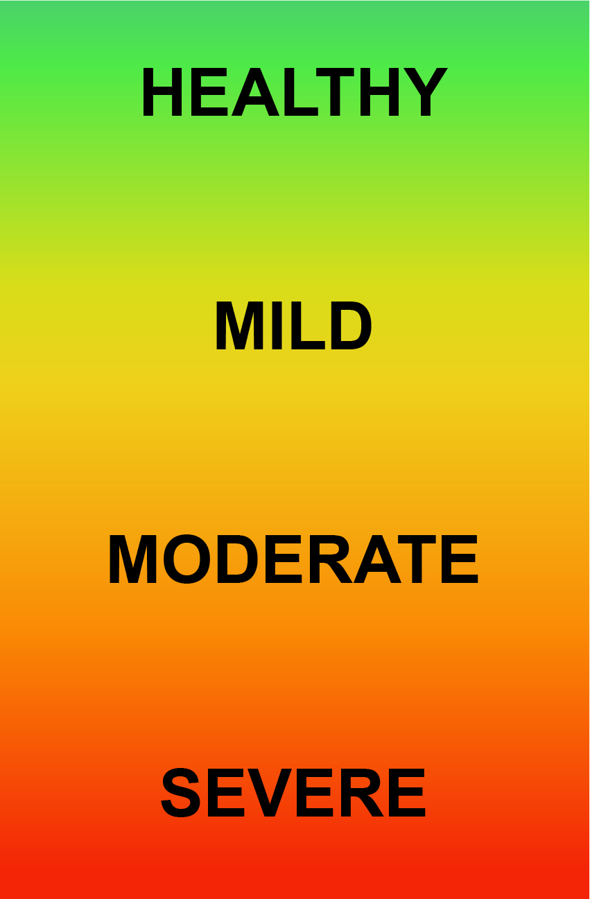
Summary
Recognize
Respond
Refer

Slide 42
“I’ve learned that people will forget what you said, people will forget what you did, but people will never forget how you made them feel.”
—Maya Angelou

Slide 43

Questions or Comments

Slide 44
Thank You
If you need further information, please contact us.

Slide 45
Attributions
Cover Slide: Photo by Pixabay, Creative Commons Zero license.
Slide 2: Sunrise at Okeover Arm in British Columbia, Canada by Islander61. Retrieved from https://commons.wikimedia.org/wiki/File:Sunrise_at_Okeover_Arm_in_British_Columbia,_Canada.jpg. This file is licensed under the Creative Commons Attribution-Share Alike 4.0 International license.
Slides 11, 12, and 41: Wellness Wheel © Jewell Gillies and Amy Haagsma (designer). Creative Commons Attribution 4.0 International license. All icons licensed as Creative Commons CC BY » yoga by zidney from the Noun Project | heart rate by Naufal Hudallah from the Noun Project | Book by Studio TROISQUATRE from the Noun Project | Gears by Gregor Cresnar from the Noun Project | Lotus by Brad Avison from the Noun Project | landscape by Creative Stall from the Noun Project | forest by Creative Stall from the Noun Project | Sea Sunset by Creative Stall from the Noun Project | Park by Creative Stall from the Noun Project | gaining by Alice Design from the Noun Project | Tree by Brian Hurshman from the Noun Project
Slide 16: Dual-Continuum Model © BCcampus based on the conceptual work of Corey Keys and a diagram created by CACUSS and Canadian Mental Health Association is licensed under a CC BY-NC (Attribution NonCommercial) license.
Slides 17: Mental Health Continuum is based on the University of Victoria continuum of mental health, which is adapted from on Queen’s University continuum of mental health and the Canada Department of National Defence continuum of mental health.
Slides 19, 22, 27, 29: https://thenounproject.com/search/?q=2283668&i=2283668. reflections of the heart by www.mingraphy.com, ES from the Noun Project. Retrieved from https://thenounproject.com/search/?q=2283668&i=2283668. This icon is licensed as Creative Commons CC BY.
Slide 28: Practicing Empathy by Melissa Hogan. Retrieved from https://commons.wikimedia.org/wiki/File:Practicing-Empathy.jpg. This file is licensed under the Creative Commons Attribution-Share Alike 4.0 International license.
Slide 39: Flower of Indian Lotus by Hong Zang. Retrieved from https://commons.wikimedia.org/wiki/File:Lotus_flower_(978659).jpg. This file is made available under the Creative Commons CC0 1.0 Universal Public Domain Dedication.
Slide 43: Diversity speech bubble icons by Louise Wigö. Retrieved from https://commons.wikimedia.org/wiki/File:Diversity_speech_bubble_icons.svg. This file is made available under the Creative Commons CC0 1.0 Universal Public Domain Dedication.

